Slide 1
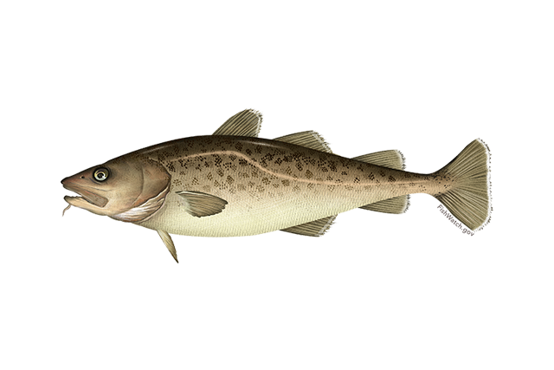
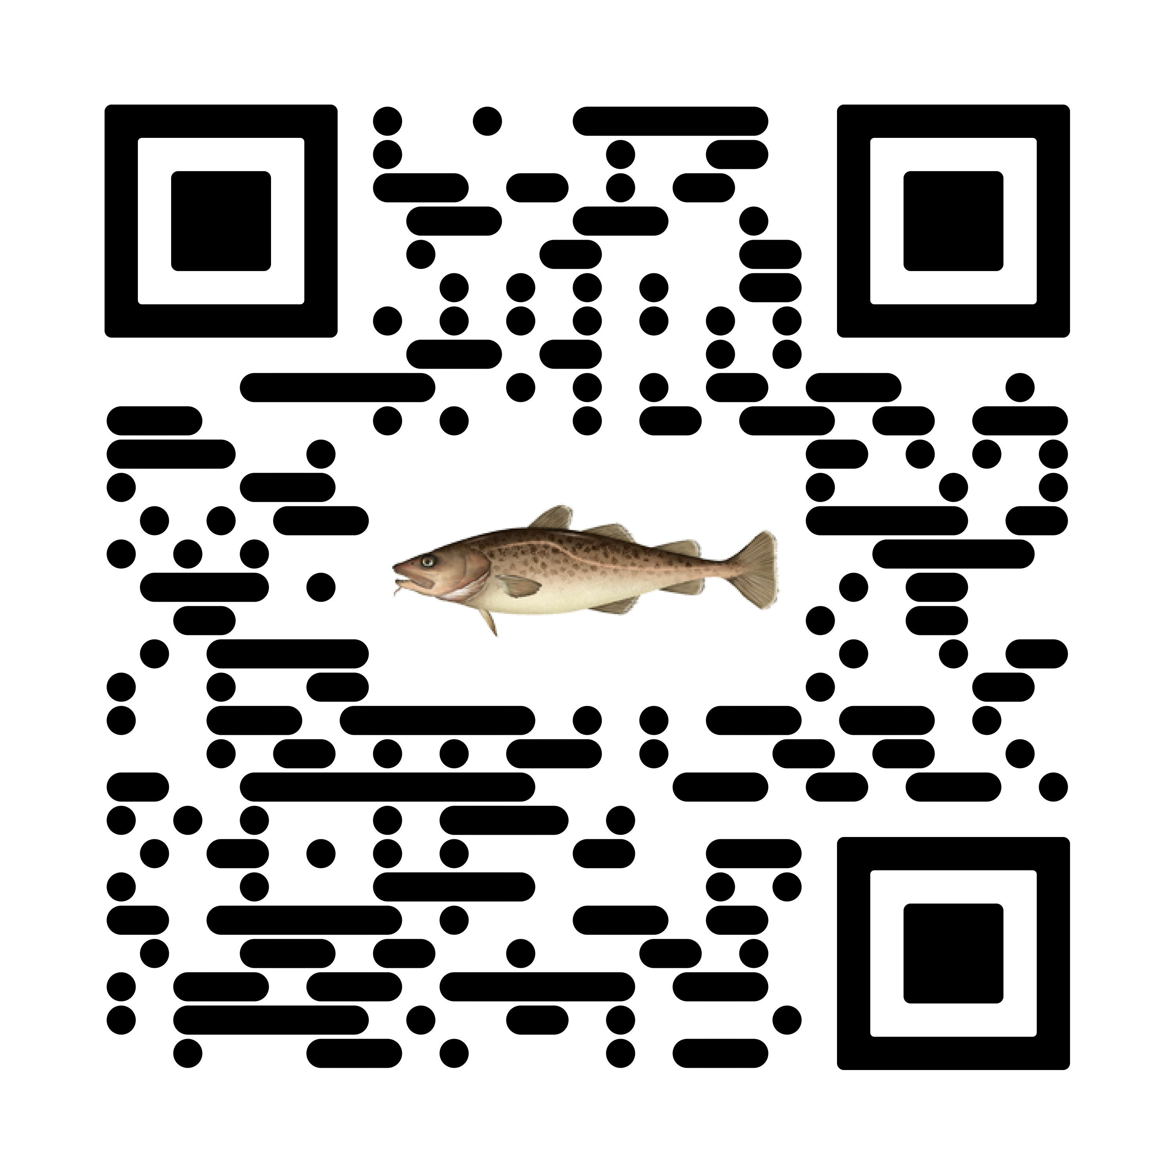

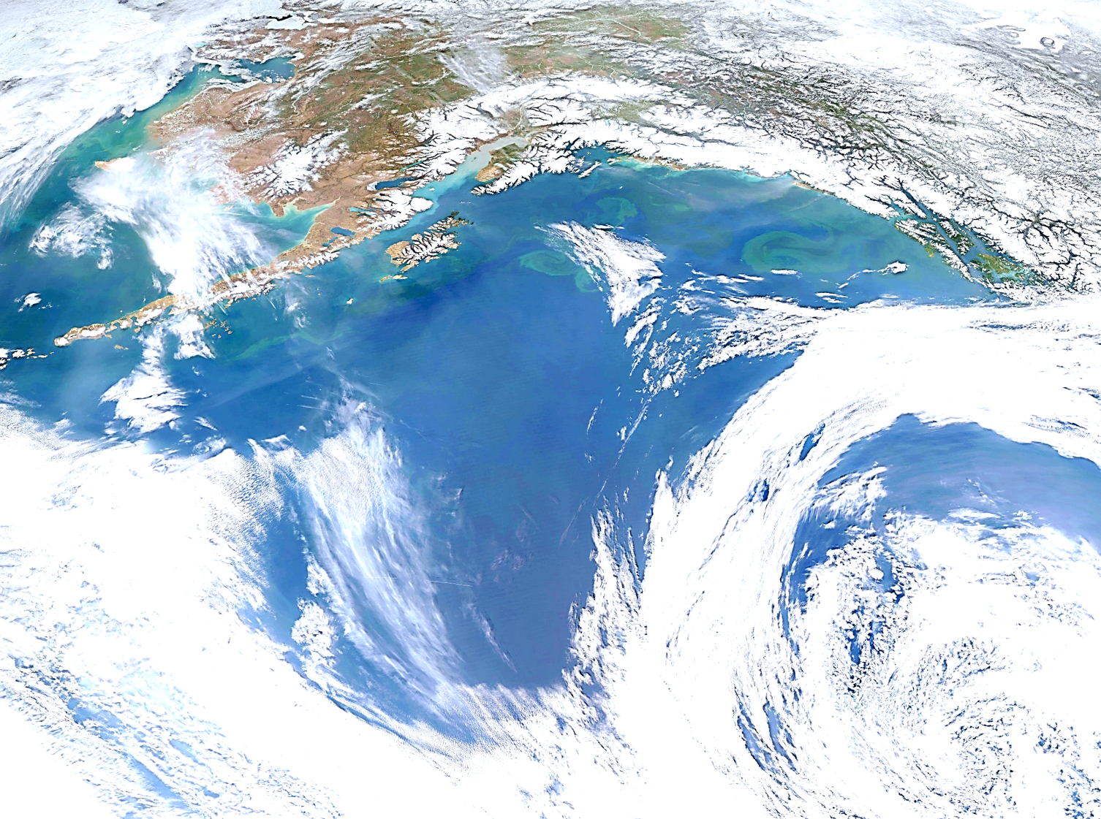

Goa pacific cod
Pete hulson, steve barbeaux, bridget ferriss, katy echave, Julie Nielsen, s. kalei shotwell, ben laurel, and Ingrid spies
November 2023, Presentation to the GOA Plan Team

Slide 2

Stock & presentation overview
BLUF:
GOA Pacific cod: Tier 3b
2024 projected spawning biomass to be at B_{29.7%}
Outline:
SSC/Plan Team comments
Changes from 2022 assessment
2023 recommended model results

Slide 3
Ssc/plan team comments: General
“The SSC supports the JGPT’s recommendation that stock assessment authors transition from the ADMB RE variants to the rema framework, which implements the same model variants in a single framework with several improvements.”(SSC, Oct 2022)
“The SSC reiterates its previous recommendation that the number of levels should be collapsed from four to three to make the choices easier for the authors.” (SSC, Dec 2022)
“The SSC supports the JGPT recommendation to make reporting of fish condition routine and standardized across assessments.” (SSC, Dec 2022)

Slide 4
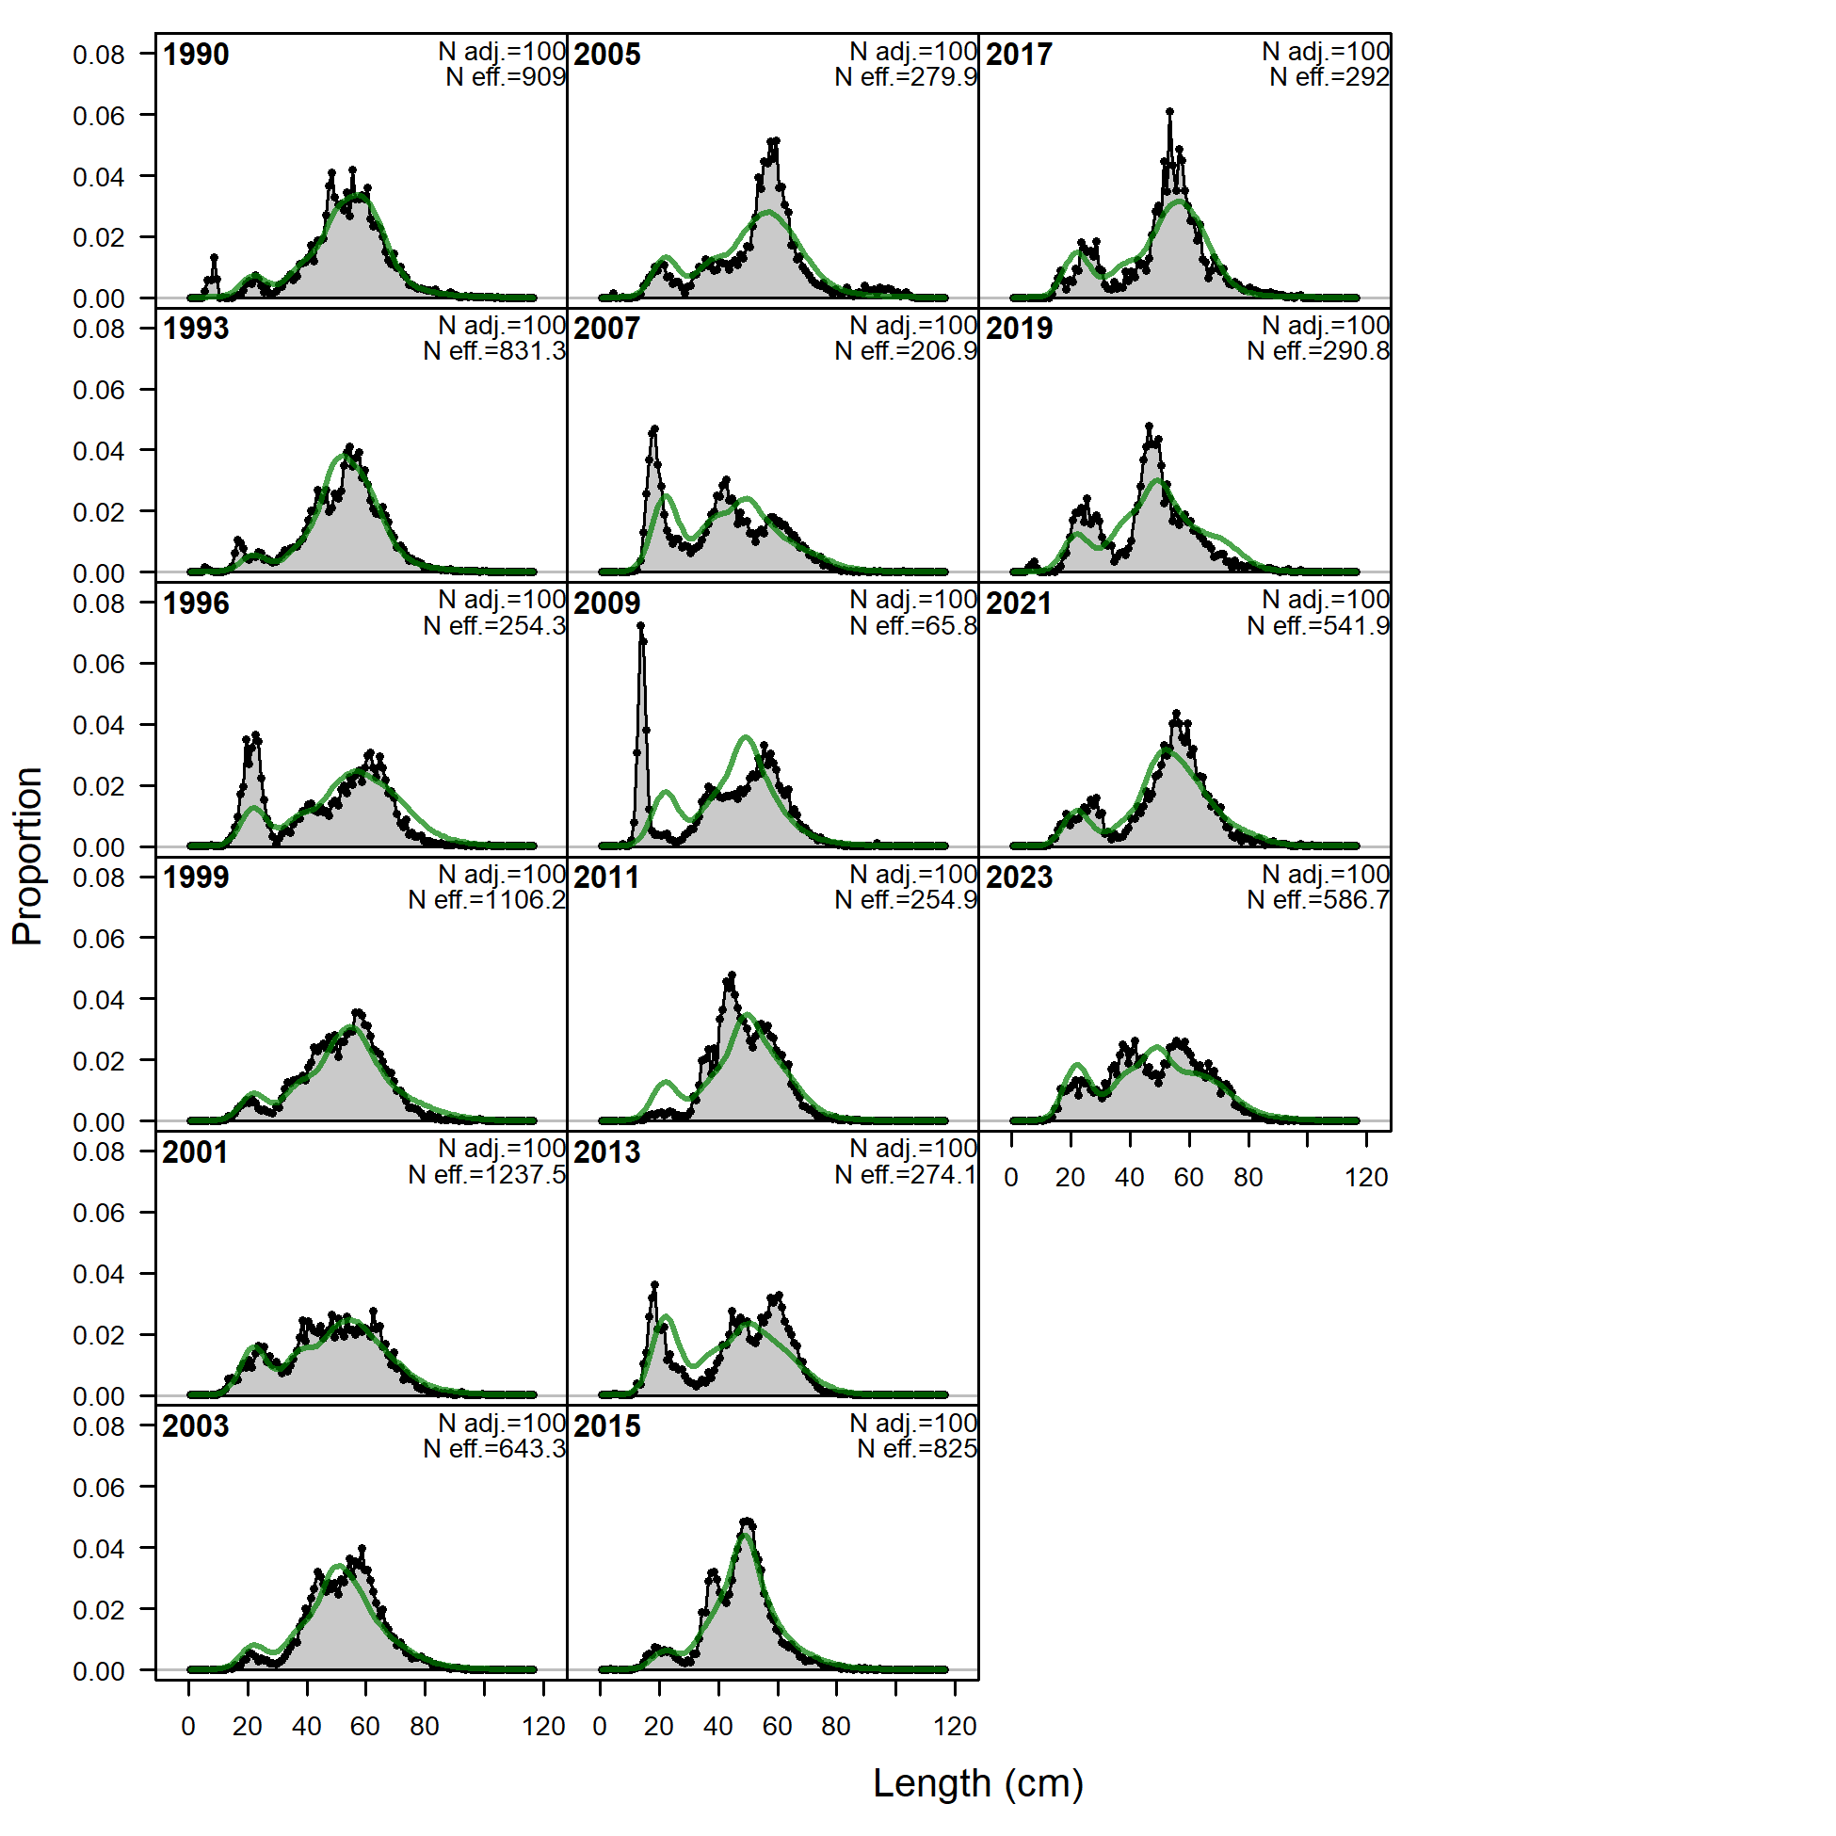
Ssc/plan team comments: specific
Specific additional recommendations include:
Provide a discussion of whether the period of elevated M estimated in recent models, and other environmentally-driven dynamics should be included in the calculation of reference points and/or stock status (see General Stock Assessment Comments)
Provide an explanation as to whether all age-classes should be expected to be affected equally by marine heat waves, and over which time periods and by what mechanism they may be affected
Please elaborate on how the Dirichlet-multinomial method verified that the current weights are “correct”
Address implausibly large standardized residuals observed for smaller fish in the fit to NMFS bottom trawl length frequency data
Provide more details about the spatial-temporal correlation that informs the historical beach-seine index where no historical data exist
Include standard MCMC diagnostics for all model parameters and derived quantities if posterior distributions are to be evaluated as part of the model results. These should include tests for burn-in, auto-correlation and mixing of the MCMC chain(s).
Explore the potential for hook-competition in the IPHC index if it is to be incorporated (SSC, Dec 2021)

Slide 5
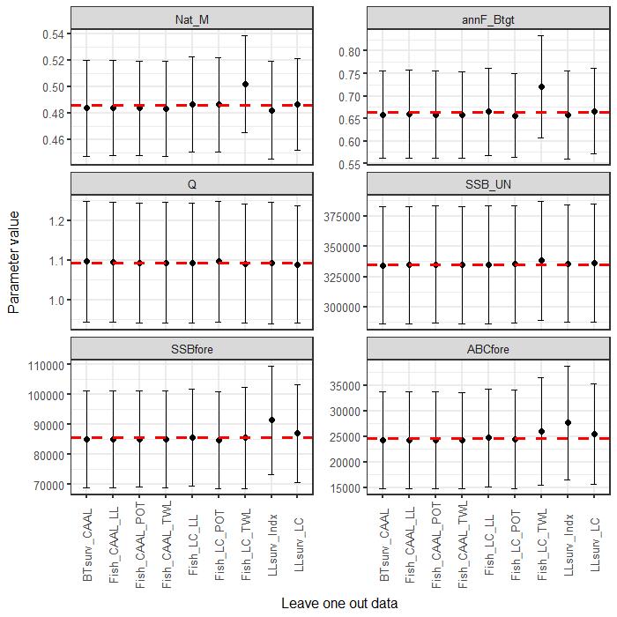
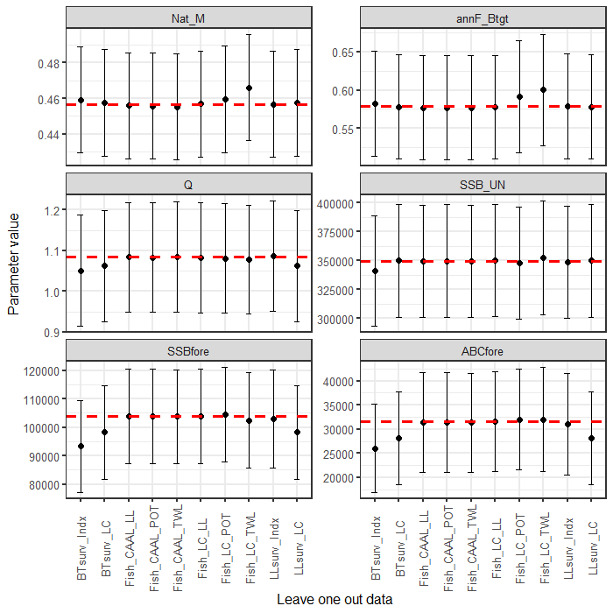
Ssc/plan team comments: specific
“The authors noted that incomplete fishery length compositions are used for the current year in the assessment. It appears that a fairly substantial amount of catch occurs after October, at least in 2022. The SSC requests that the authors evaluate the benefit of including these data by showing the complete versus incomplete length compositions for the past few years and a retrospective of the assessment including and excluding these data.” (SSC, Dec 2022)
2022
2023

Slide 6
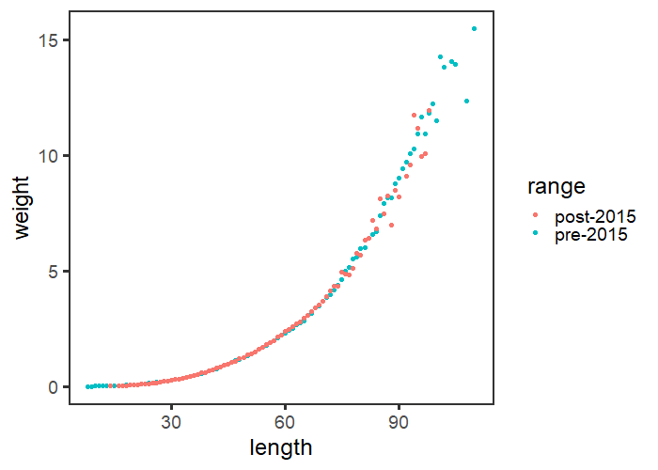
Ssc/plan team comments: specific
“The SSC appreciates the preliminary evaluation of conditional age-at-length patterns and recommends further evaluation of growth-related issues, including updating the length-weight relationship with more recent data, evaluating if there have been significant growth changes, and examining empirical weight at age. The SSC encourages consistency with EBS and AI cod assessments in approaches to these and other issues, where possible.” (SSC, Dec 2022)
“The Team recommended that the data for length-weight relationships be reevaluated and examined for sensitivity to the trends over time and areas.” (Plan Team, Nov 2022)
“The Team recommended the authors look at the model-predicted mean weight-at-age (by gear type), and compare to the observed weight-at-age data to see if there are discernible spatial or temporal patterns that the model is missing.” (Plan Team, Nov 2022)
“The Team recommended that an evaluation comparing how growth changes may affect the residuals be pursued. The Team also recommended the author investigate whether size-based selectivity affects the patterns observed.” (Plan Team, Nov 2022)

Slide 7
Ssc/plan team comments: specific
“Based on recent tagging and genetic studies, the SSC encourages further exploration of fish movement as a potential major cause of population changes. Movement should be considered in concert with high natural mortality events for future models, and specifically consideration should be given to an Alaska-wide stock or GOA/EBS model.” (SSC, Dec 2022)

Slide 8
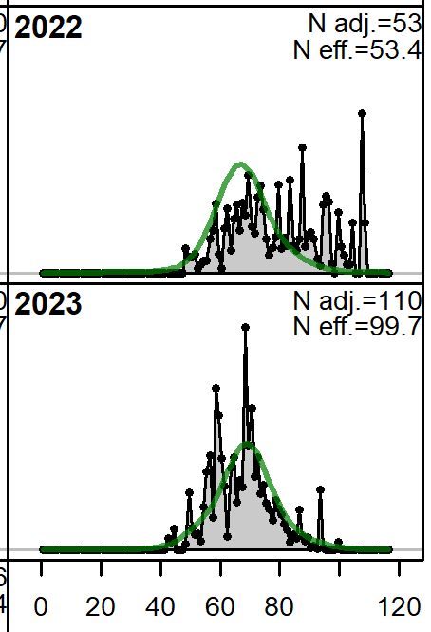
Ssc/plan team comments: specific
Specific additional recommendations include:
The SSC reiterates their encouragement for the authors to consider whether information from the IPHC setline survey and NMFS longline survey, alongside the NMFS bottom trawl survey, may provide a superior basis for apportionment recommendations, perhaps through the use of an integrated spatiotemporal model or a multi-survey random effects model.
Along with analyses addressing other previous recommendations, the SSC looks forward to an investigation of large residuals in the fit to pot fishery data and for smaller fish in the fit to bottom trawl survey data.
The SSC suggests including information on changes in fishing practices that may explain the increase in the mean length of cod caught in pot fisheries (Figure 2.14).
The SSC requests the authors provide the mean catchability used in the calculation of the temperature-adjusted and time-varying q (SSC, Dec 2022)

Slide 9
Ssc/plan team comments: specific
The Team recommended adding confidence intervals on the mean lengths by depth strata. Additionally, the Team recommended that the authors compare total fishing effort or catch (in addition to total sample size) to be sure that the observer coverage is capturing effort appropriately. (Plan Team, Nov 2022)
“The Team recommended examining the updated MCMC tools (e.g., adnuts) and diagnostics.” (Plan Team, Nov 2022)
“Relative to the time-varying longline survey catchability being linked to an environmental covariate, the Team recommended that it be re-examined against a fixed value for comparison.” (Plan Team, Nov 2022)

Slide 10
Changes from 2022 assessment
Weighting of conditional age-at-length
Changed minimum sample size from 1 (19.1a) to 0.001 (19.1b)
Likelihood component | Model 19.1a | Model 19.1b
TOTAL_like | 4084.3 | 2931.0
Survey_like | -7.9 | -3.3
Length_comp_like | 1821.9 | 1817.9
Age_comp_like | 2256.2 | 1102.0
Recruitment | -0.5 | -0.5
InitEQ_Regime | 3.1 | 3.1
Forecast_Recruitment | 3.9 | 4.3
Parm_priors_like | 1.2 | 1.0

Slide 11
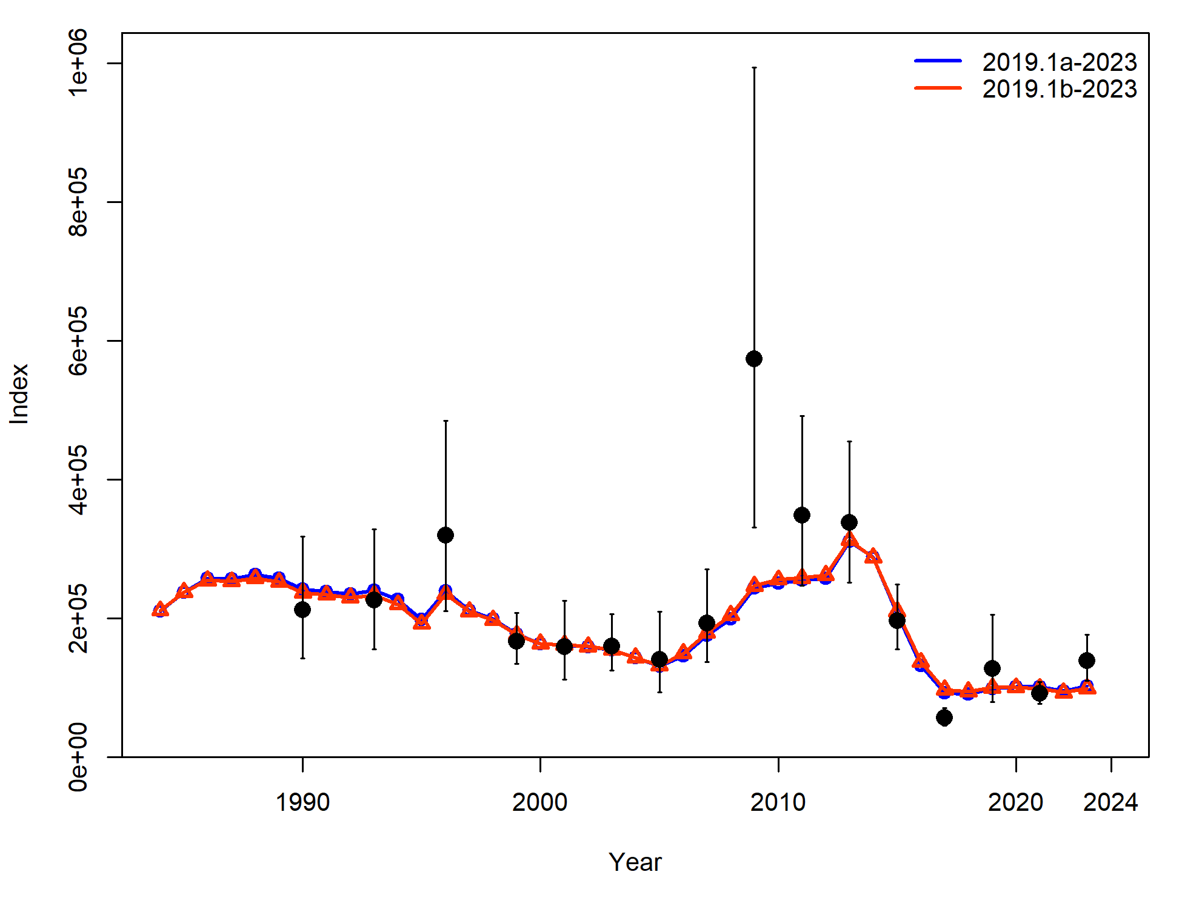
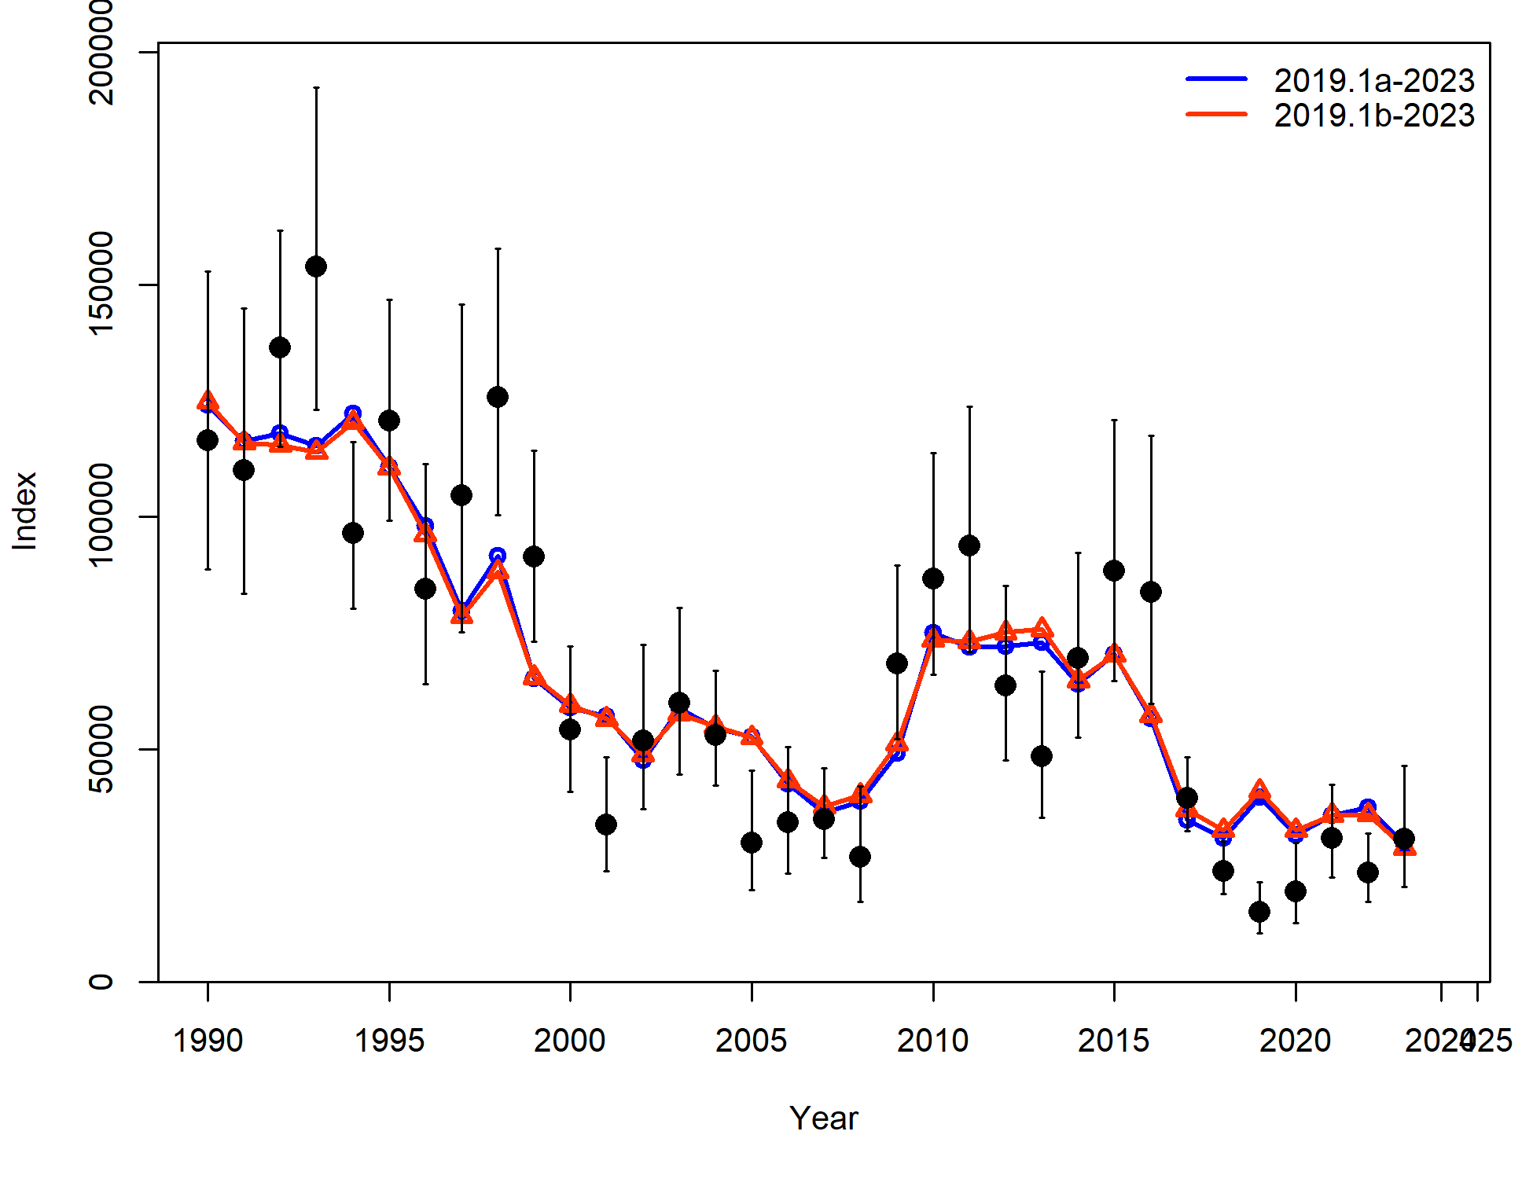
Changes from 2022 assessment

Slide 12
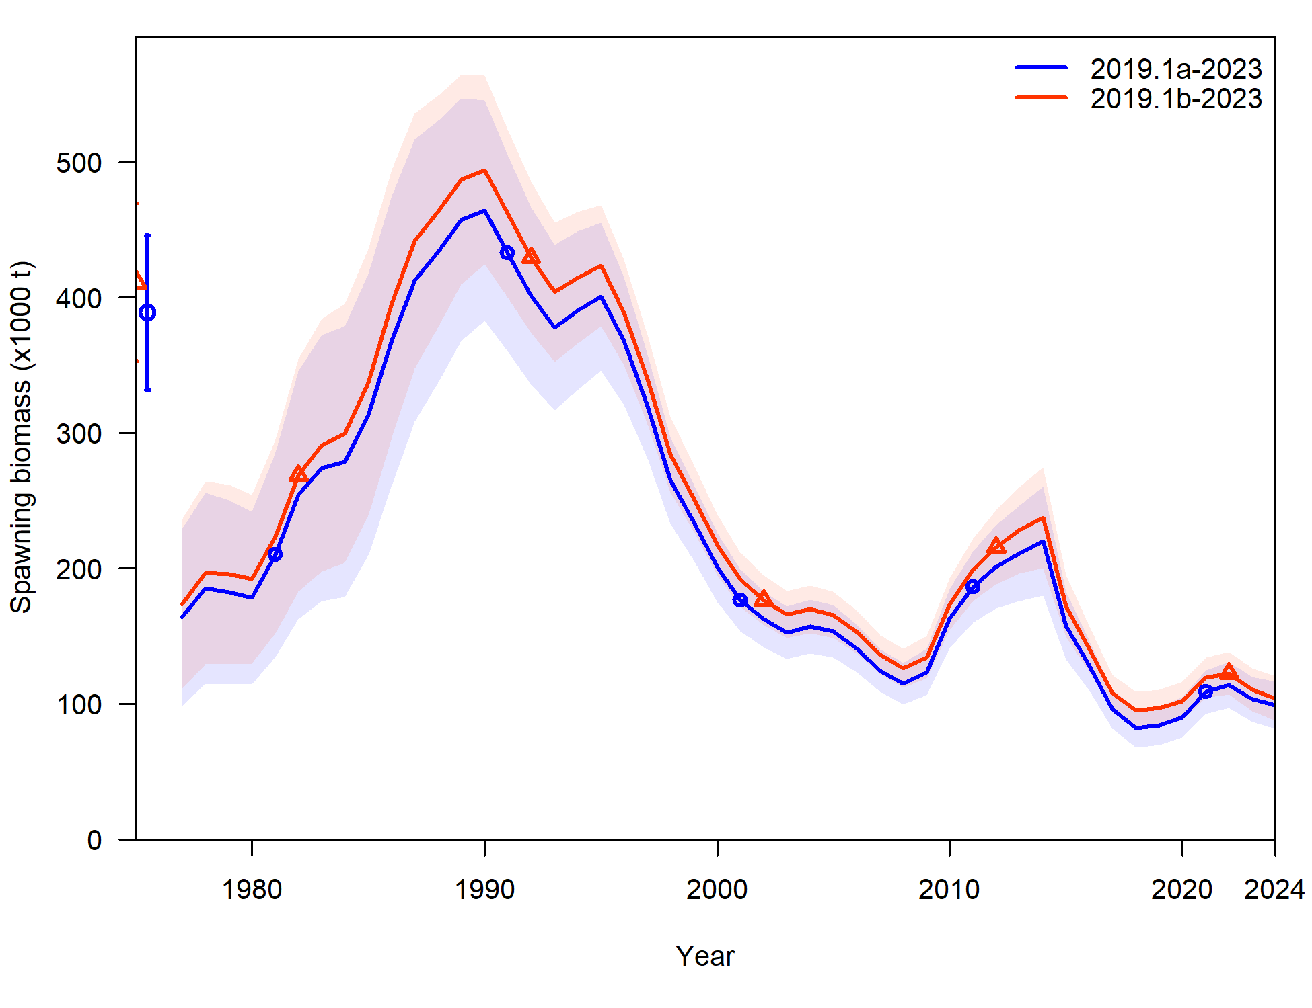
Changes from 2022 assessment
Recommend Model 19.1b to use for 2023 assessment

Slide 13

Assessment evaluation Outline
Data
Fishery
Results
Model fits
Params
Recommendations
Risk table
ABC/OFL
Surveys
Other
Derived quantities

Slide 14

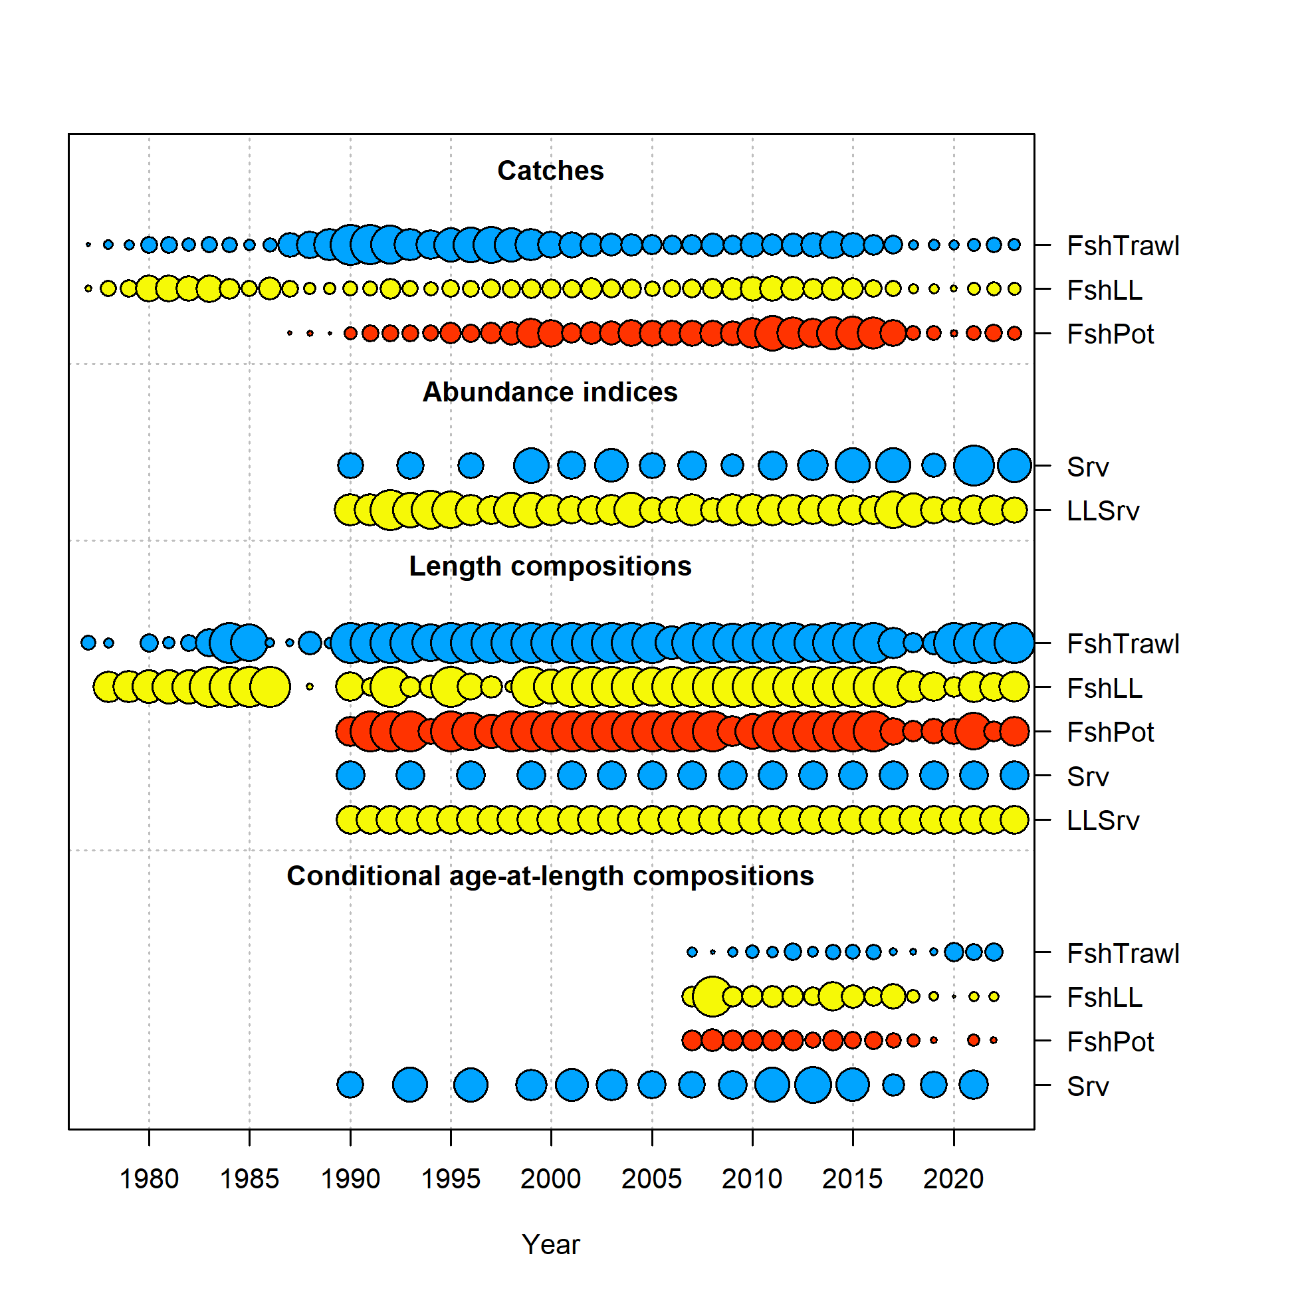
Data overview
Data | Years
Federal and state fishery catch, by gear type | 2022, 2023
Federal and state fishery length composition, by gear type | 2022, 2023
Federal fishery conditional age-at-length | 2022
GOA NMFS bottom trawl survey abundance and length composition | 2023
AFSC Sablefish Longline survey Pacific cod RPNs and length composition | 2023
CFSR bottom temperature indices | 2023

Slide 15
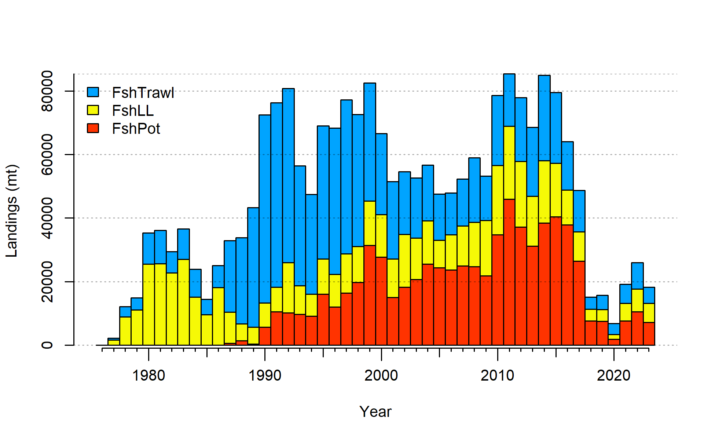
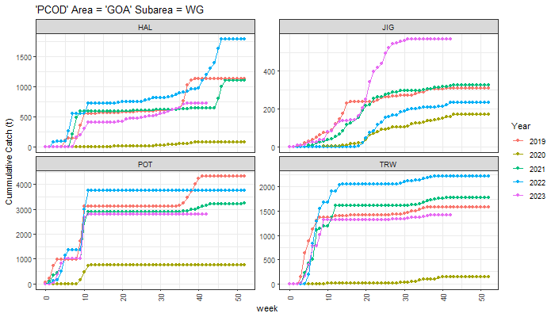
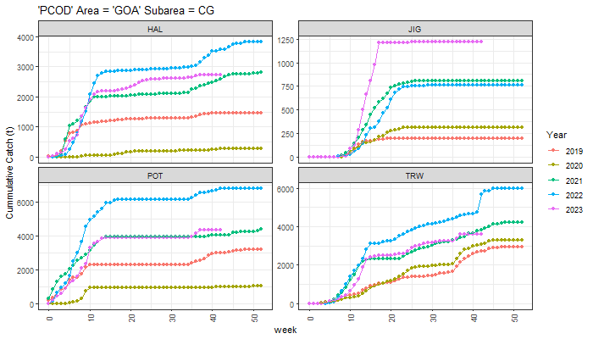
Data - Catch
Decreased since 2022
Pot majority > LL > Trawl
Large jig increase compared to previous years, others similar to what was seen in 2021

Slide 16
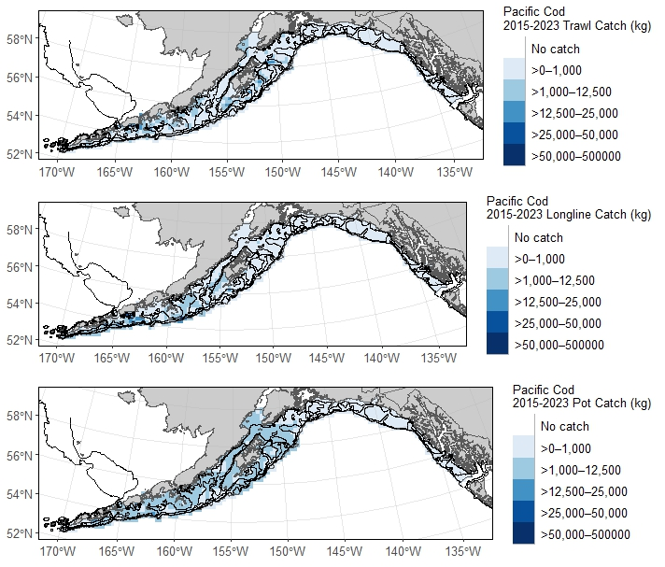
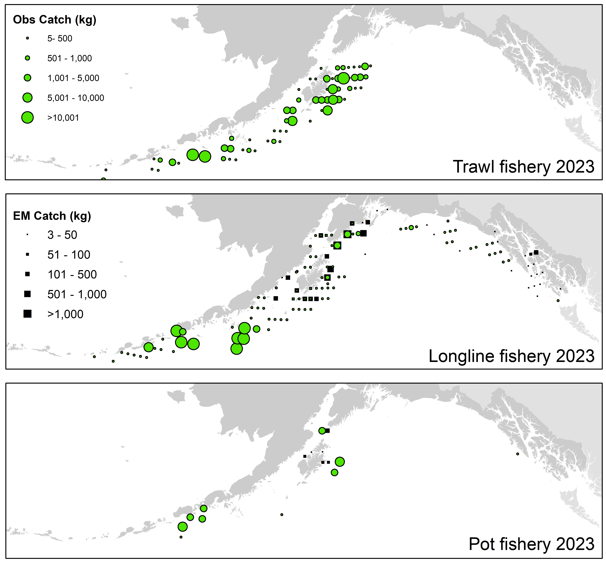
Data – Catch distribution
2023 distribution similar to catch distribution since 2015
For how much relative catch is taken by pot, small # observed hauls

Slide 17
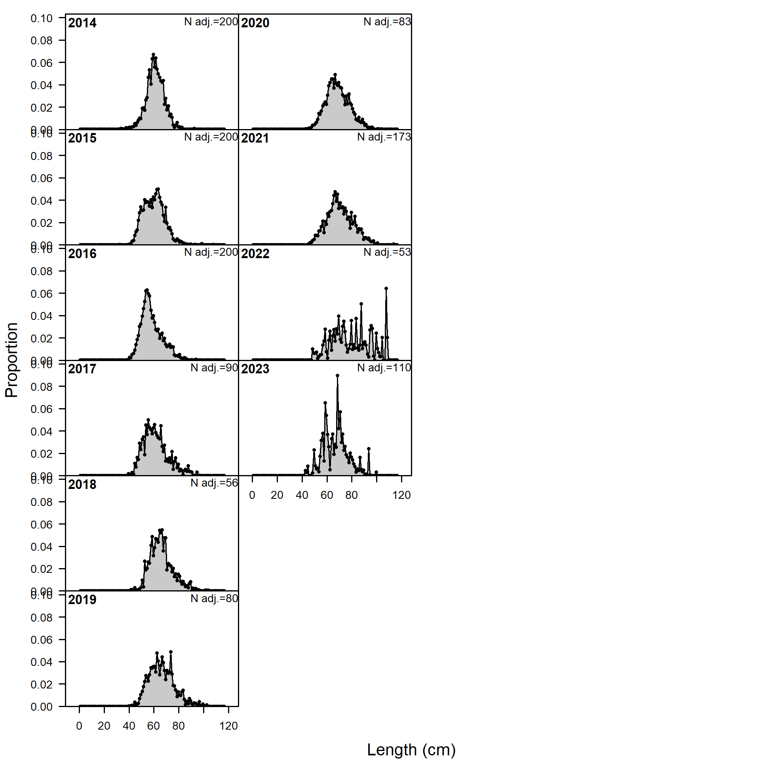
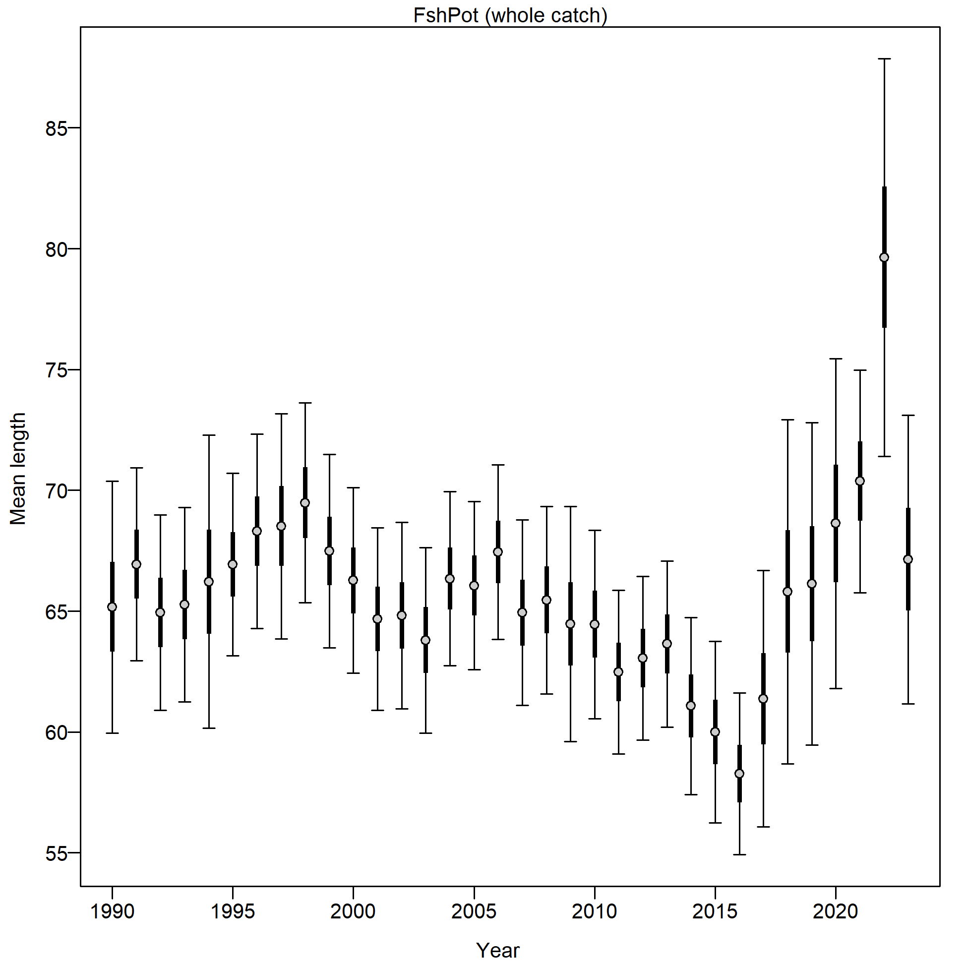
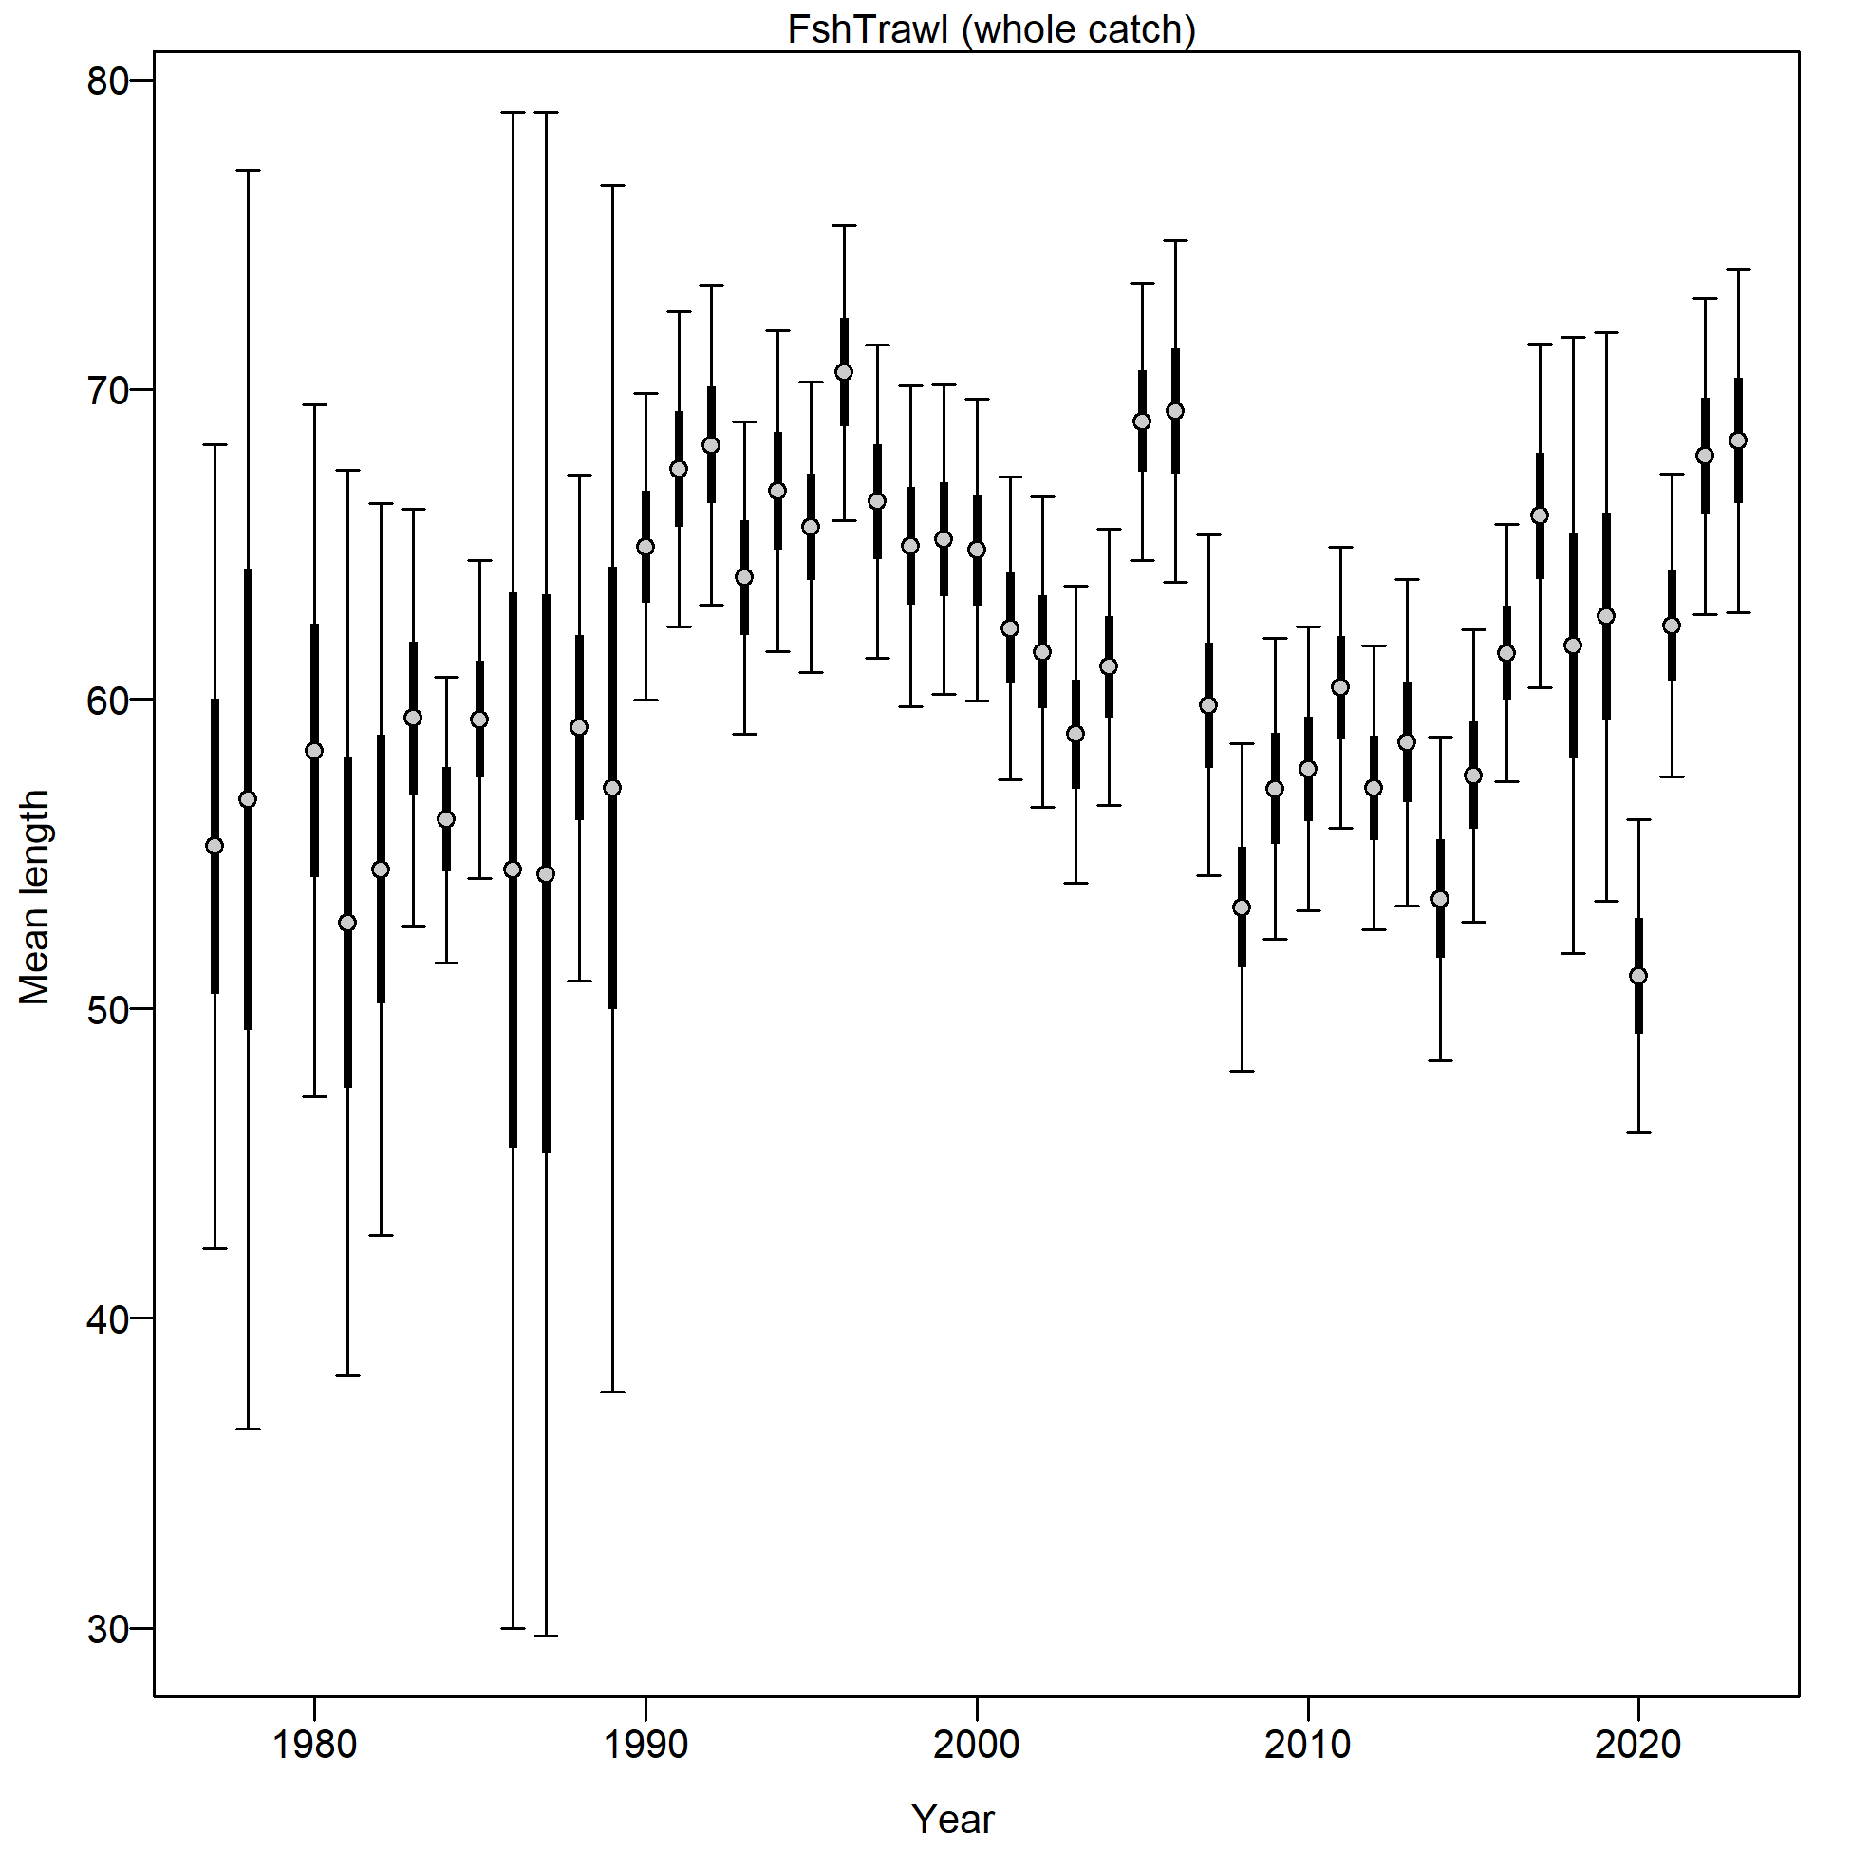
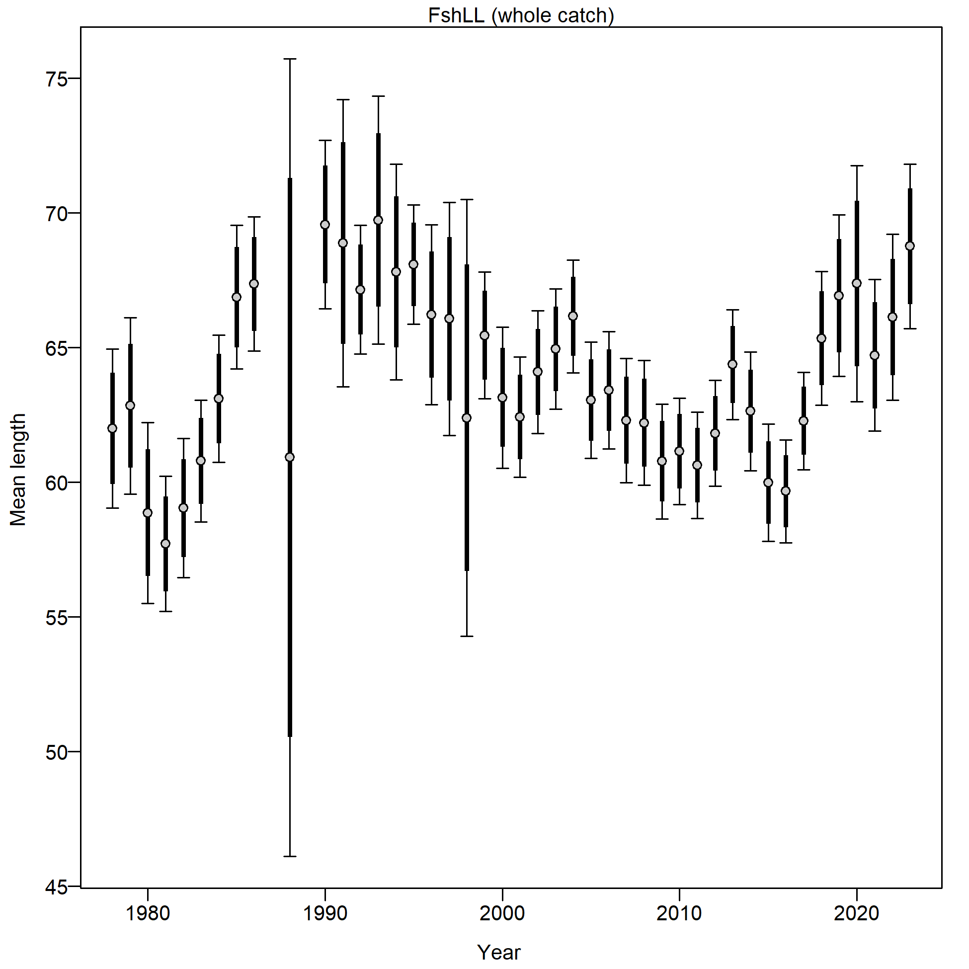
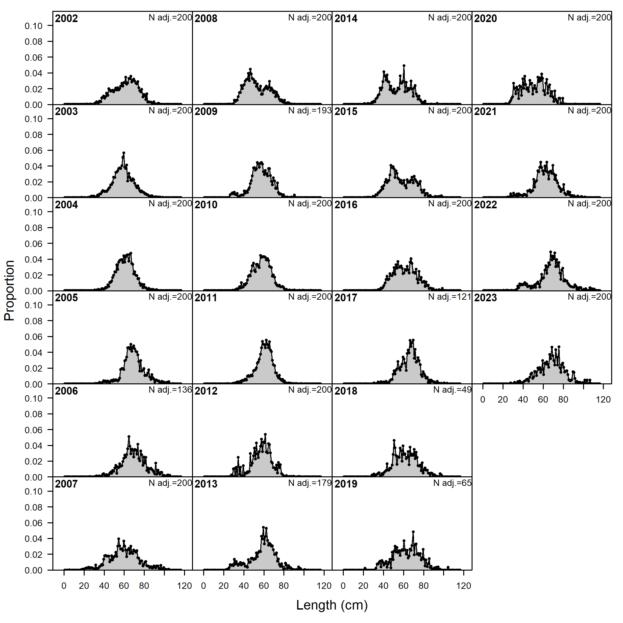
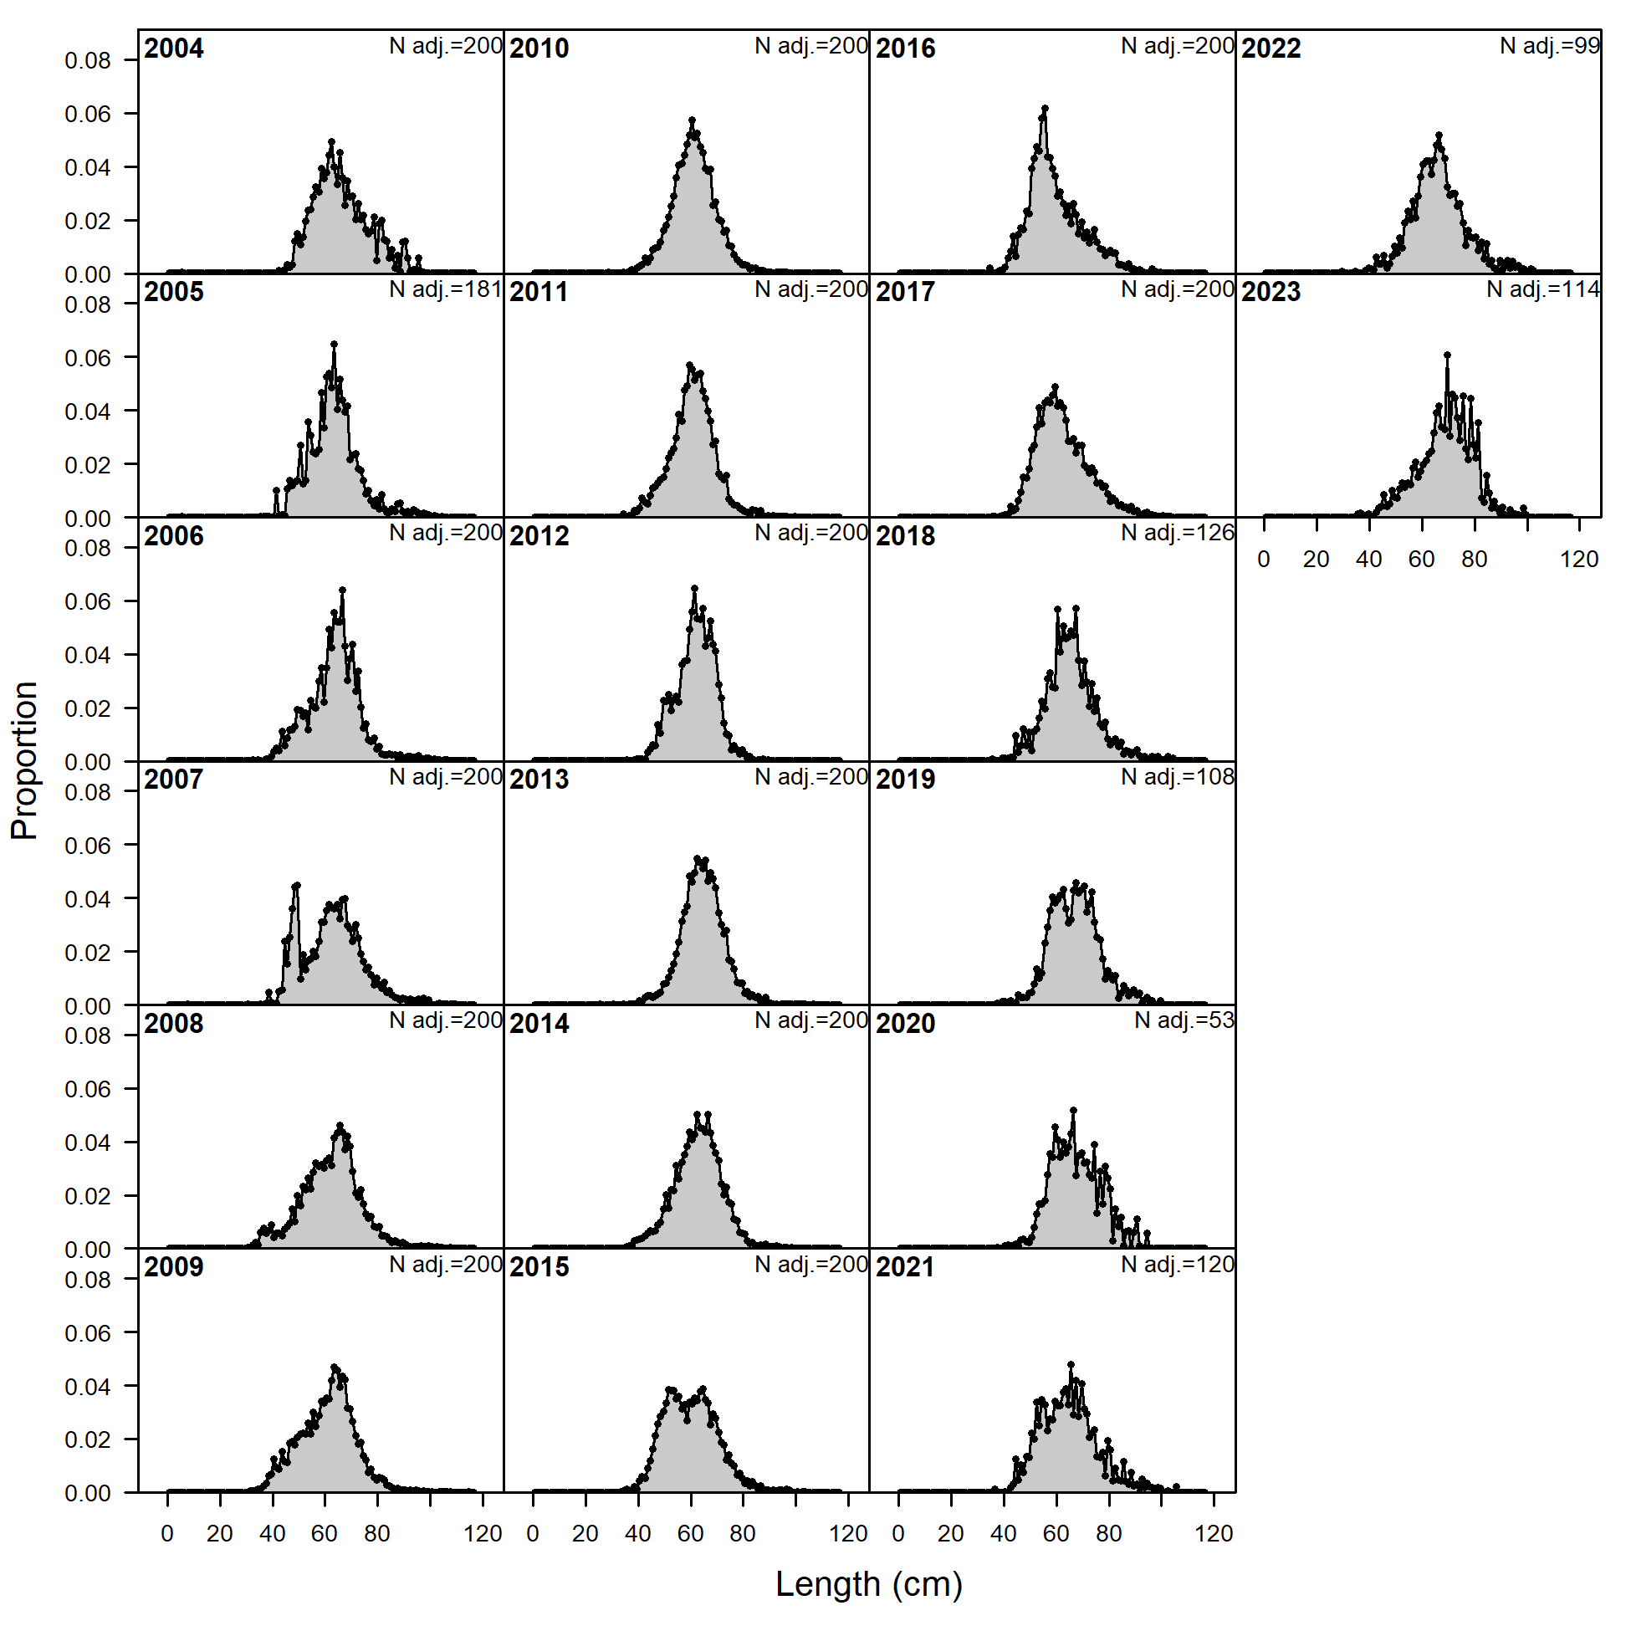
Data – catch comps
In general, mean length since 2015 larger than recent time periods (but on scale of that seen in 1990s)
Larger mean length that resulted in Pot fishery for 2022 has come back down in 2023, likely a sampling artefact
Dug into pot sampling
Pot
Trawl
Longline

Slide 18
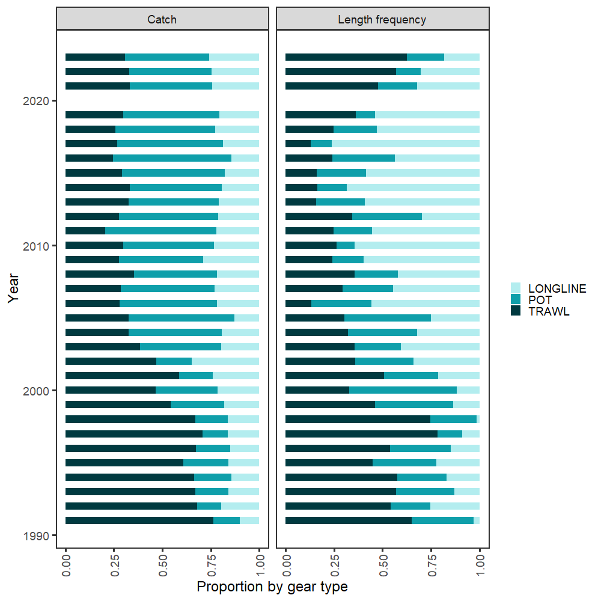
Data – catch comps
1st pass evaluating observed effort of Pot fleet: distribution of length samples

Slide 19
Data – catch comps
2nd pass evaluating observed effort by gear type (Trawl, Longline, Pot):
Relative proportion of catch by gear type: gear specific catch divided by total annual catch
Relative proportion of observed catch by gear type:
Step 1: for each gear type, divide observed catch (extrapolated weight summed across hauls, converted to mt) by total catch
Step 2: with proportions from Step 1, compute relative proportions across gear types
Simple example: 10% of total catch observed for gear type 1, 5% of total catch observed for gear type 2 => 66% of relative proportion of observed catch is for gear type 1, 33% for gear type 2. If the observed catch rates were the same (i.e., 50/50), then the catch is observed proportional to the overall relative catch by gear type – so what we’re looking for is an even split among gear types
Relative proportion of observed catch sampled for length frequency by gear type:
Same procedure as for observed catch, but use observed catch from hauls that have length frequency sampling

Slide 20
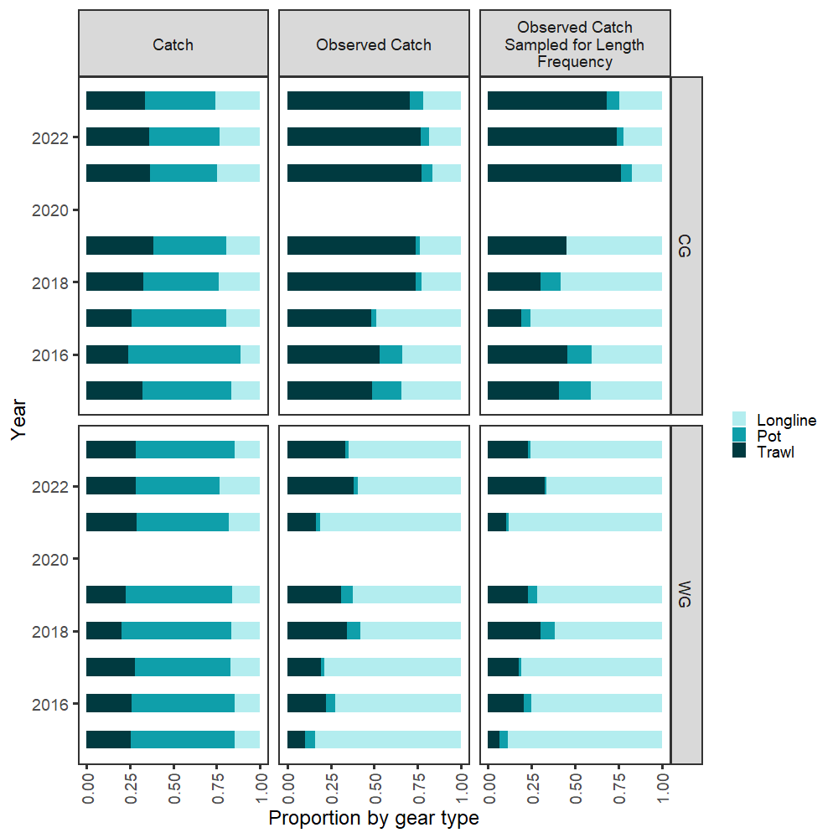
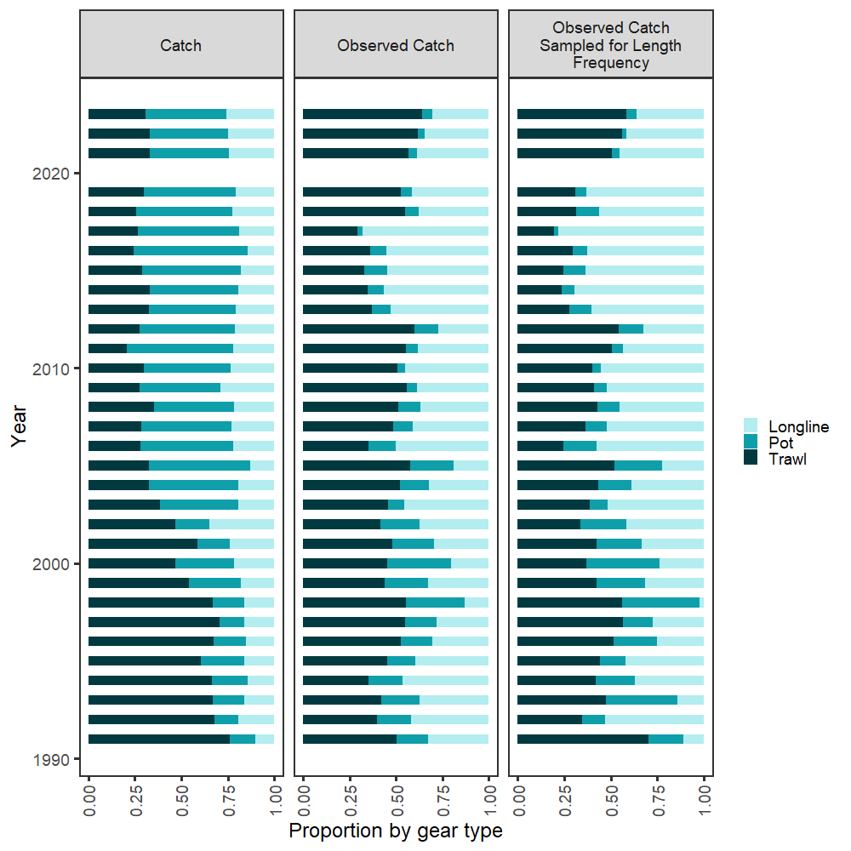
Data – catch comps
Pot fleet underrepresented in both observed catch and length frequency

Slide 21
Data – catch comps
Pot fleet underrepresented in both observed catch and length frequency

Slide 22
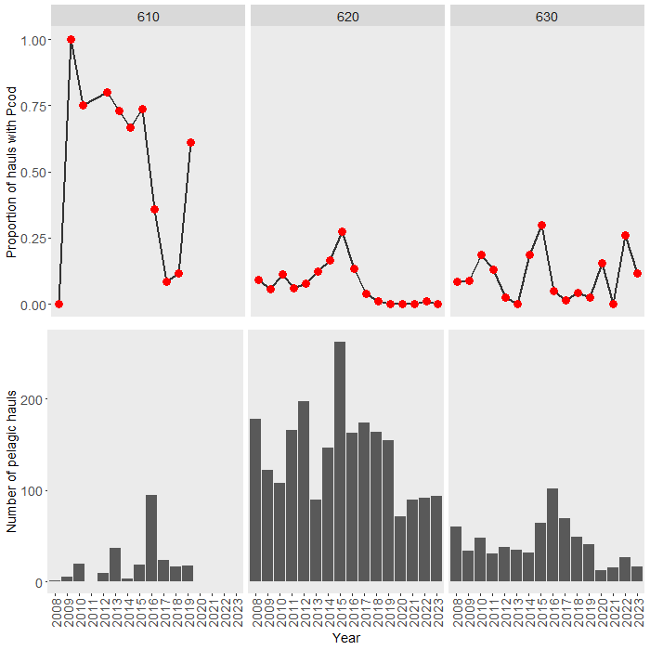
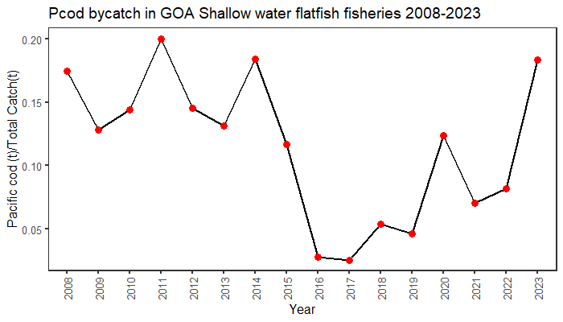
Data – unintentional catch
Getting Pcod in pelagic trawls (can be thought of as index of juveniles)
SWF bycatch on increasing trend (index of adults)

Slide 23
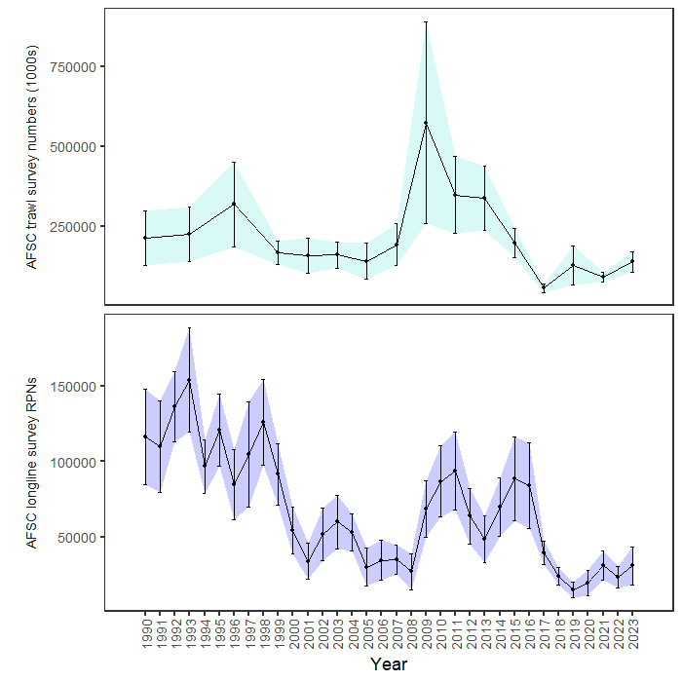
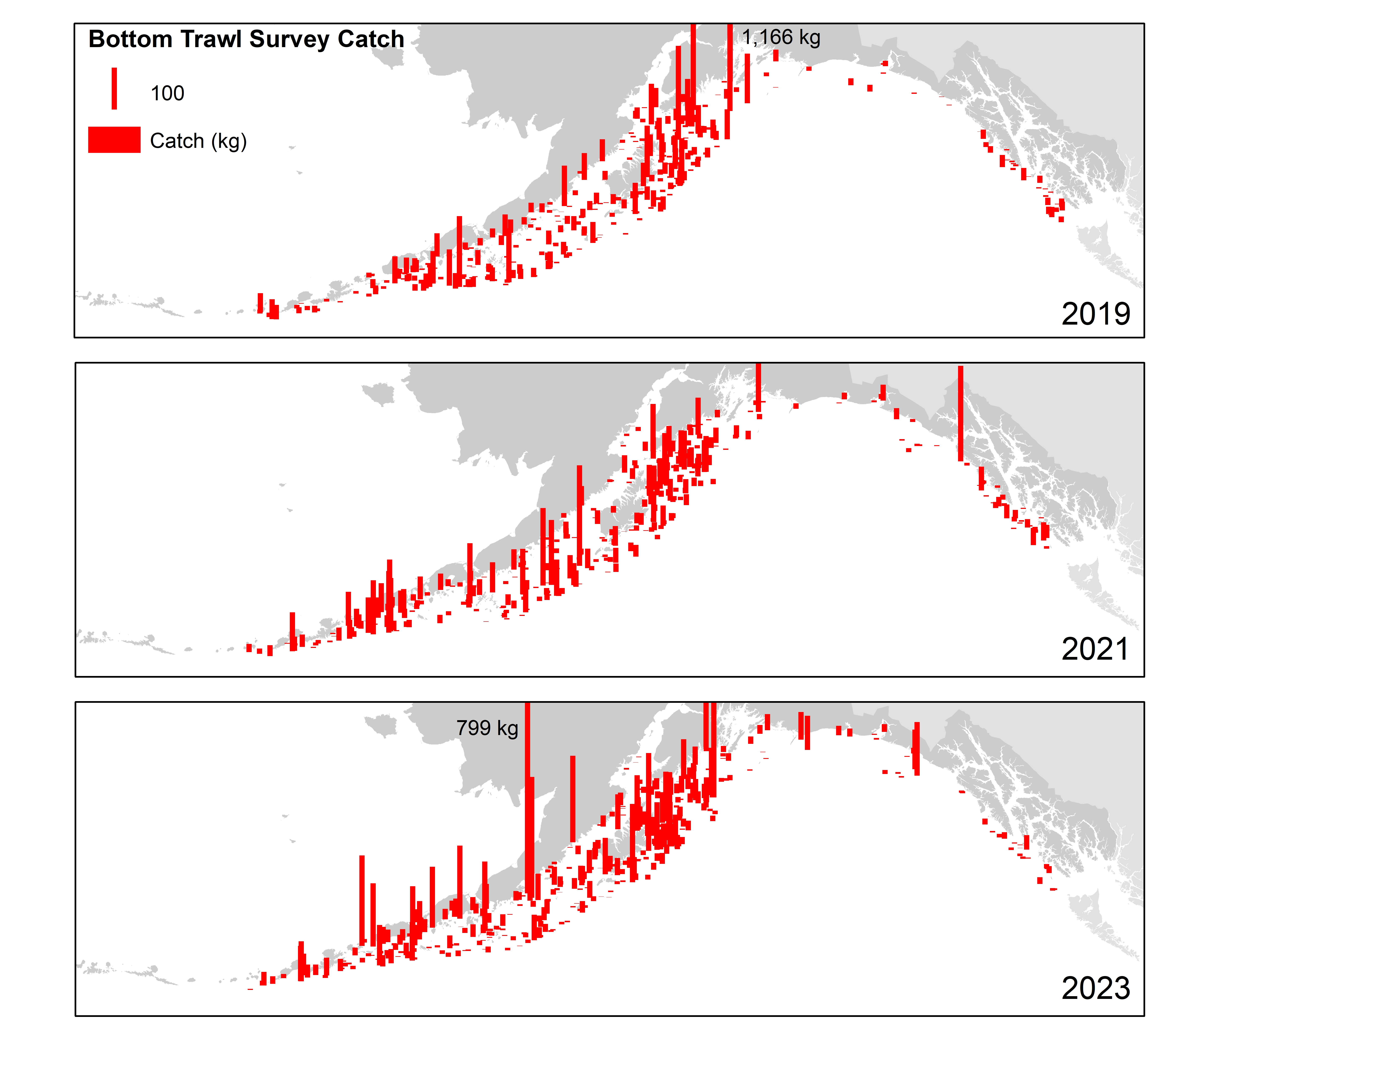
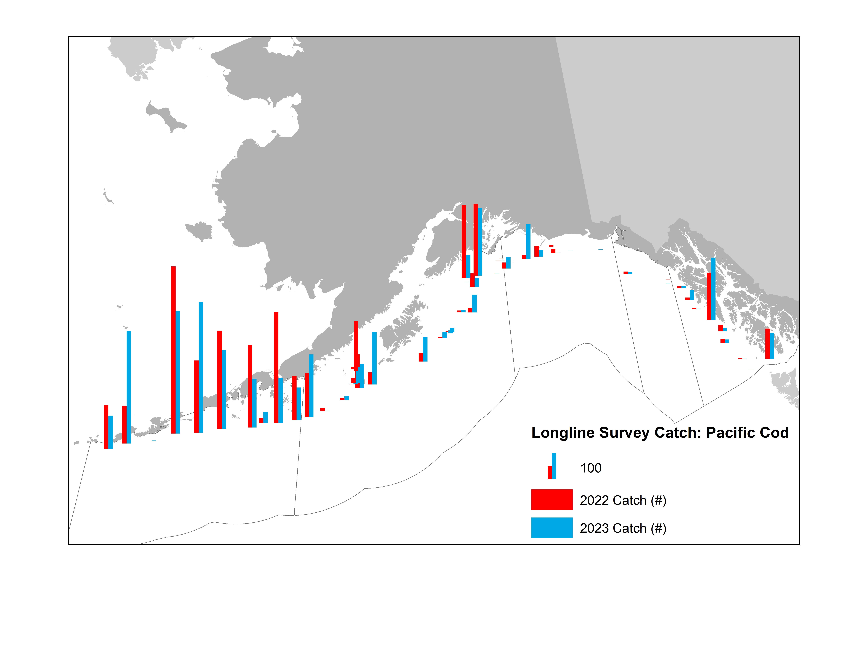
Surveys – fitted
+53%
+32%

Slide 24
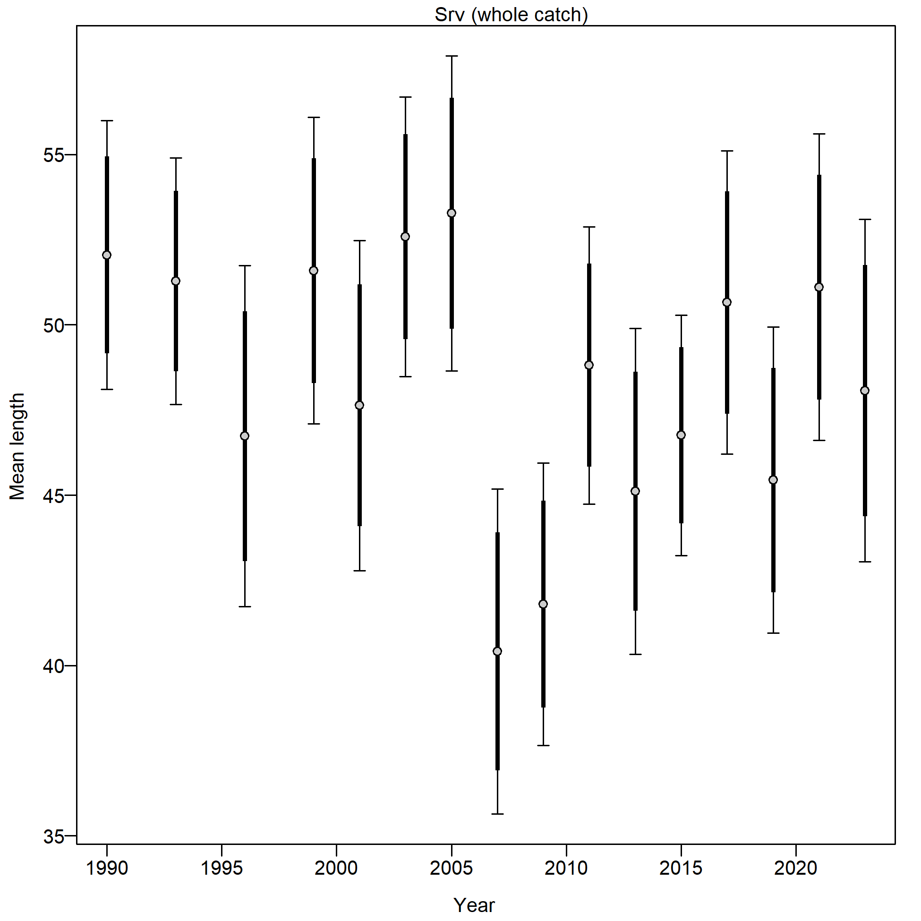
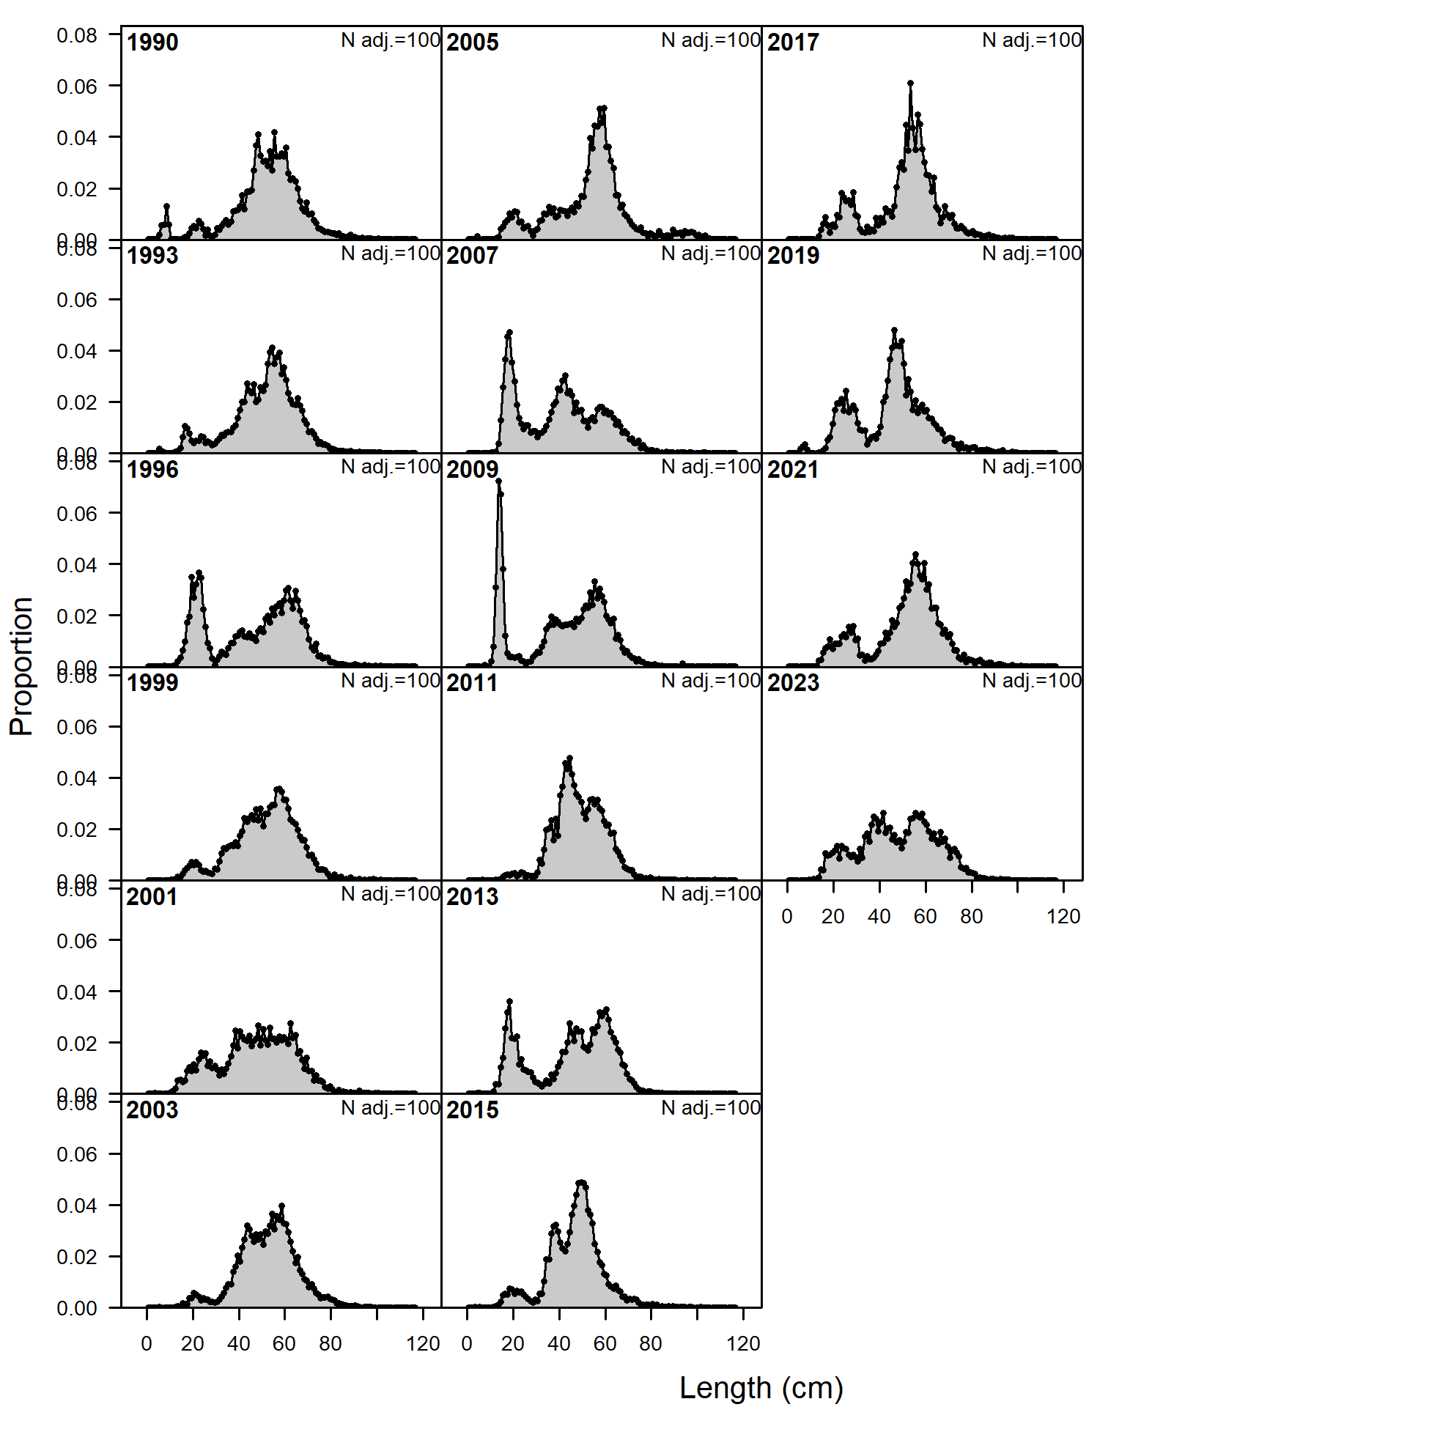

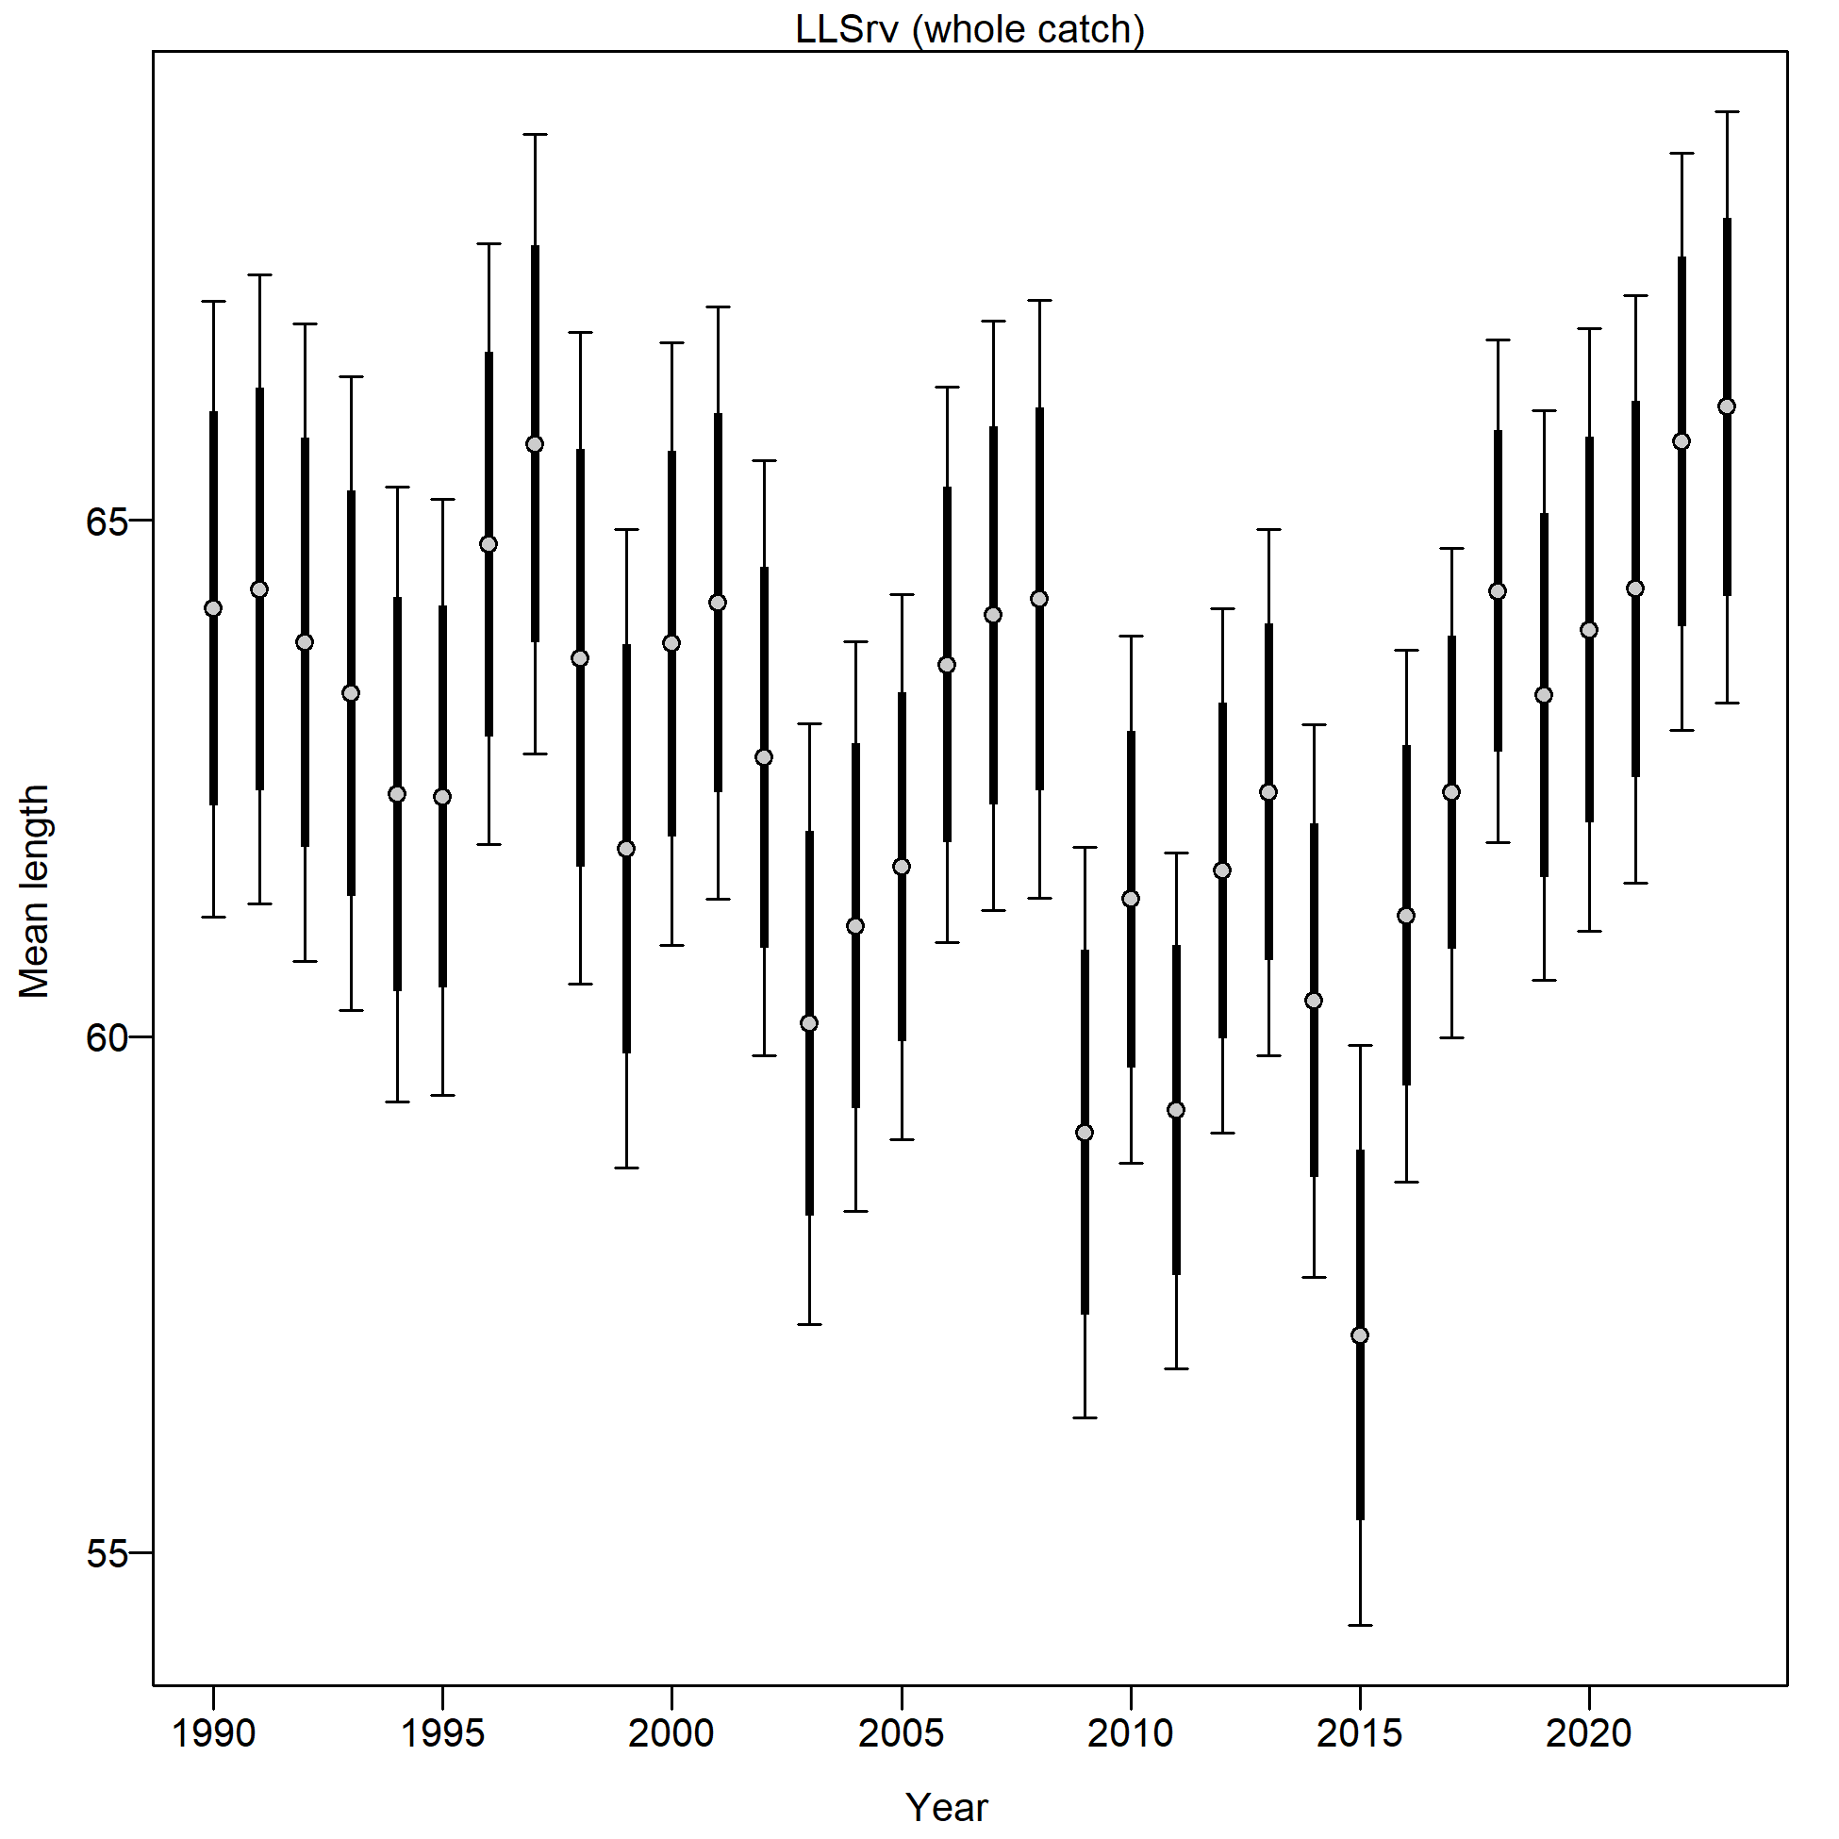
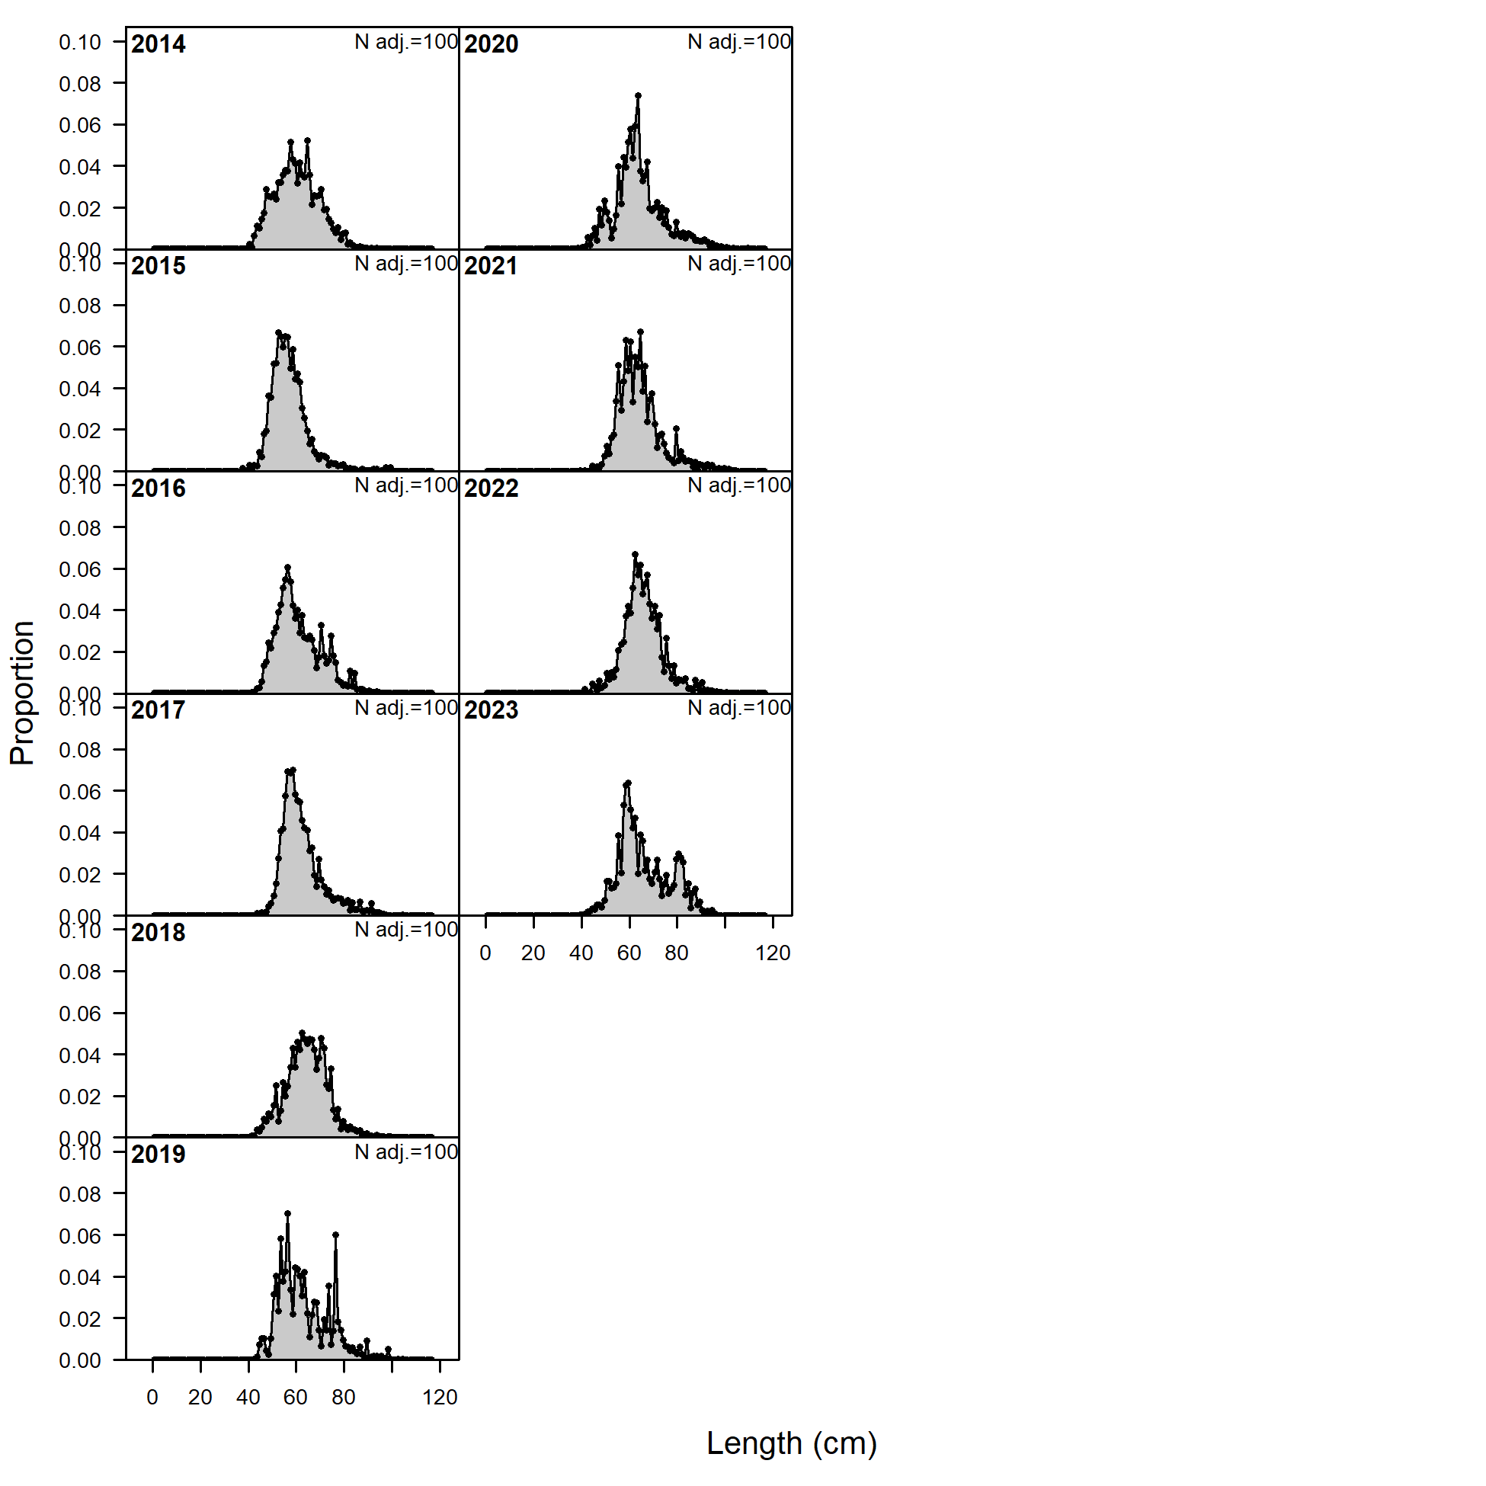
Surveys – Fitted
Trawl survey mean length variable
Longline survey mean length increasing

Slide 25
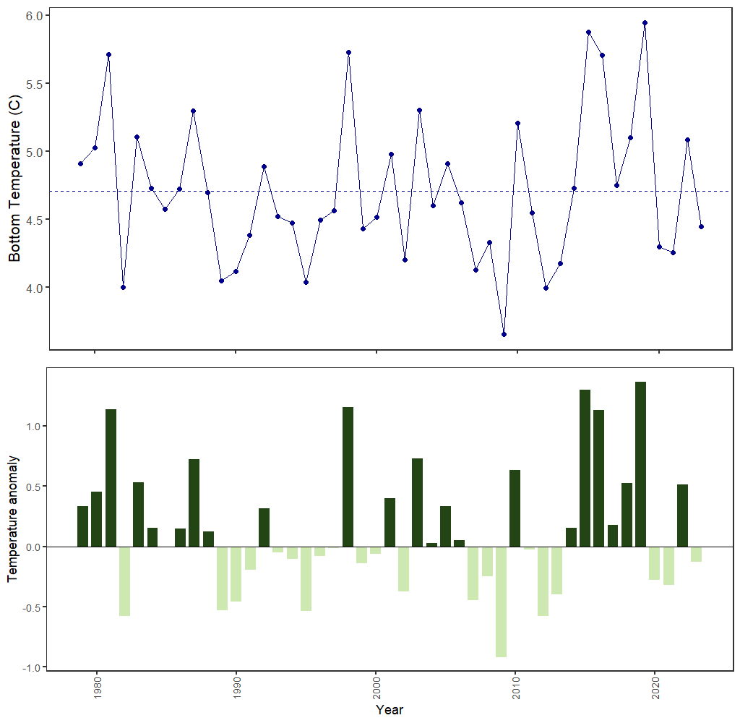
Surveys – Env data
Bottom temperature below mean in 2023

Slide 26
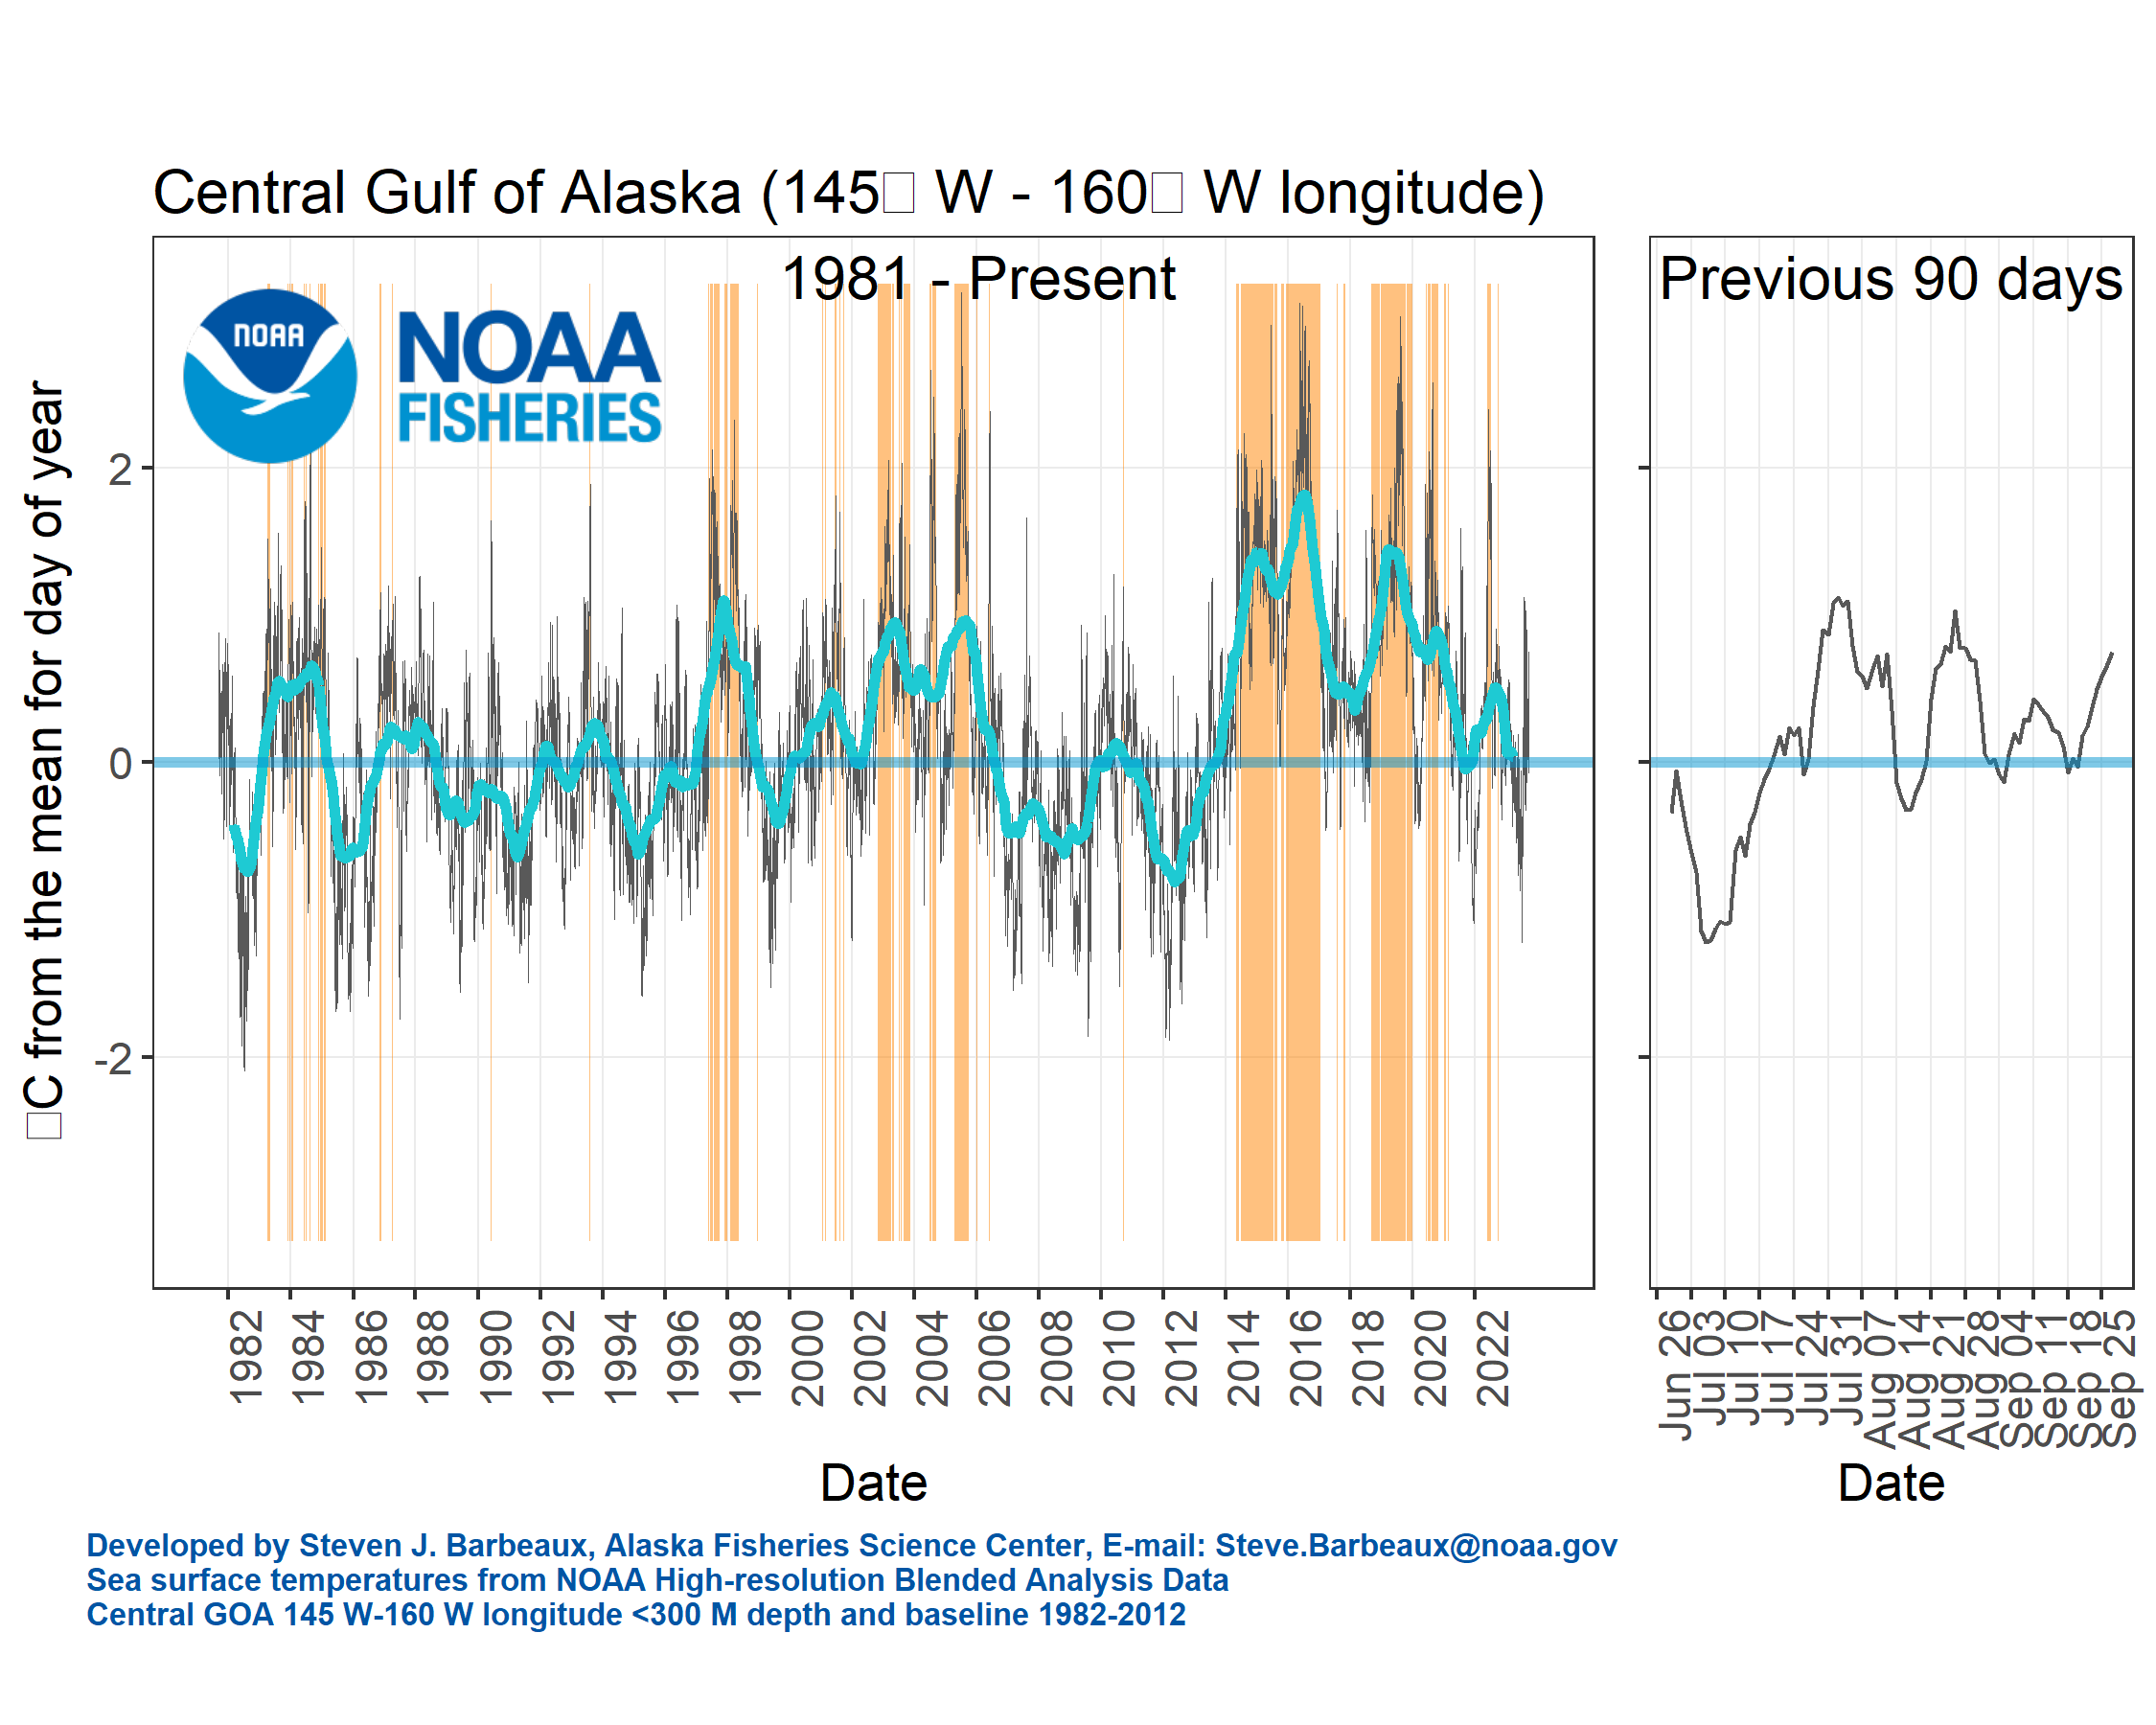
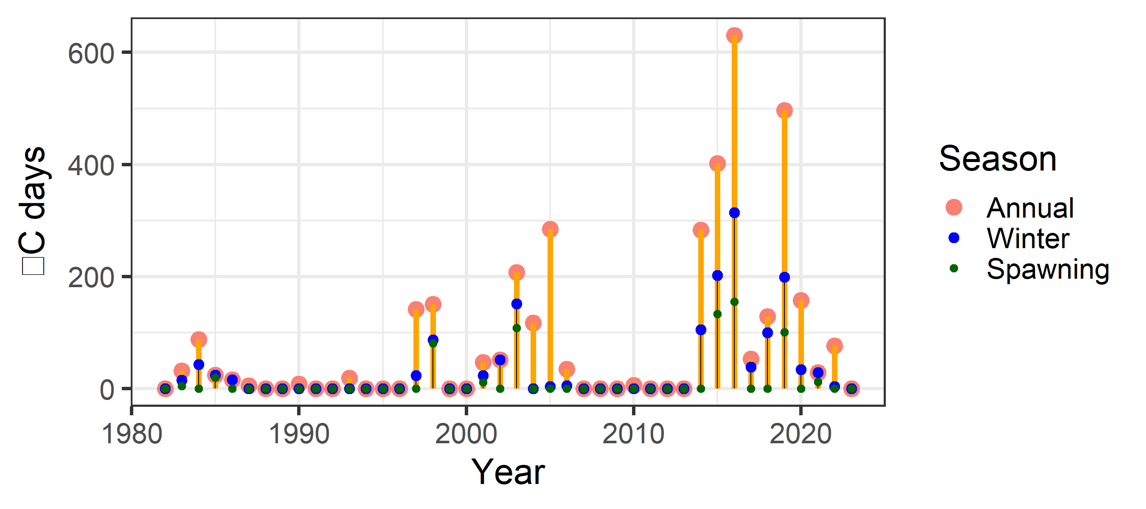
Surveys – Env data
Avg sea surface temperature
No marine heat wave days

Slide 27
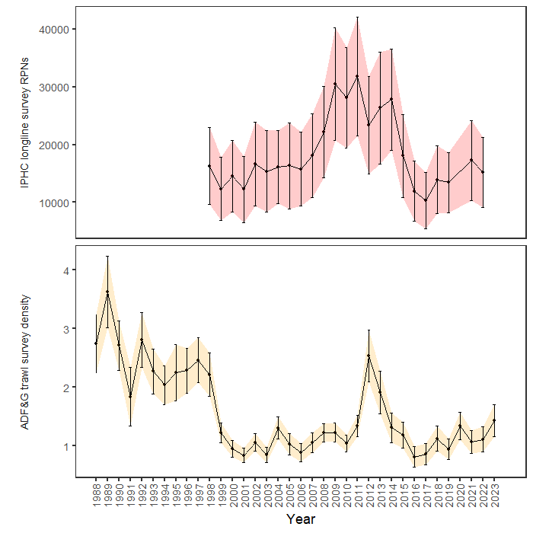
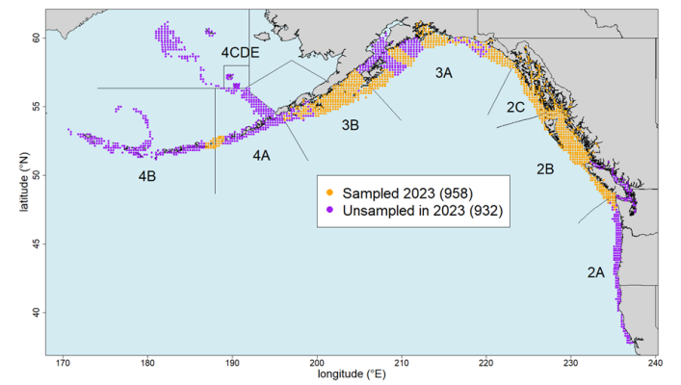
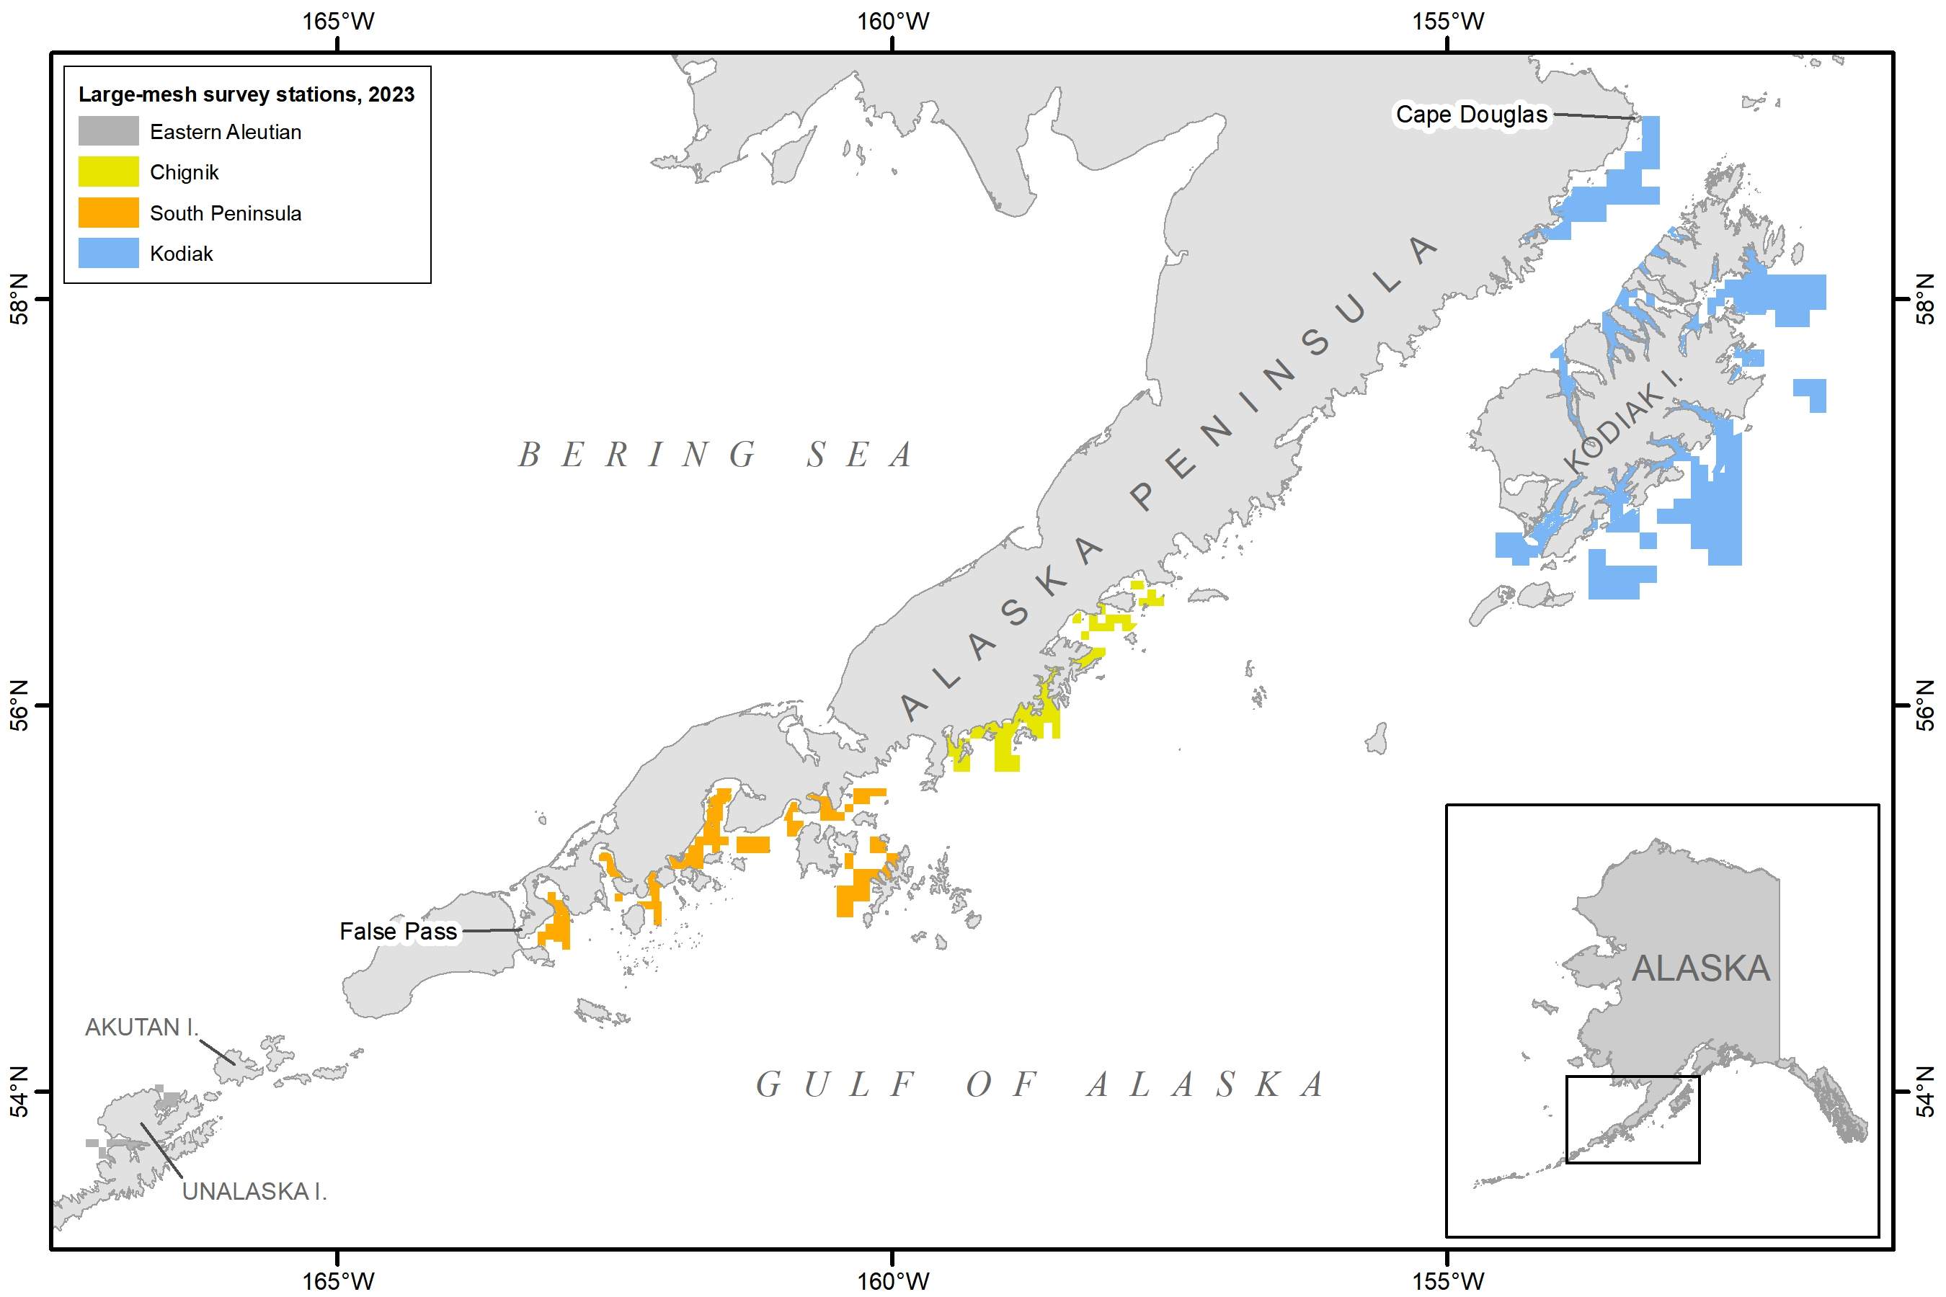
Surveys – monitored
Both IPHC and ADF&G on increasing trend

Slide 28
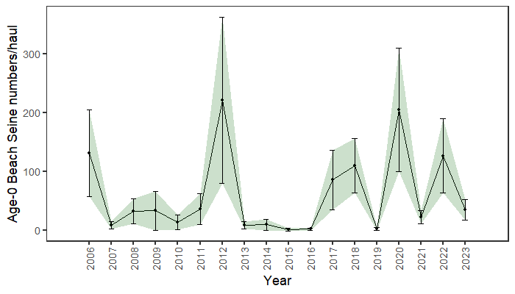
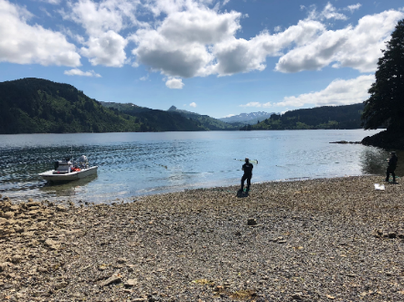
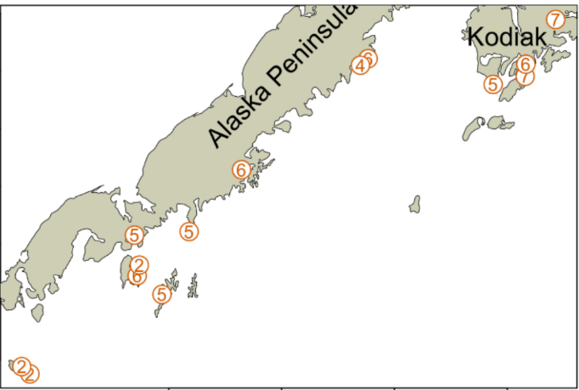
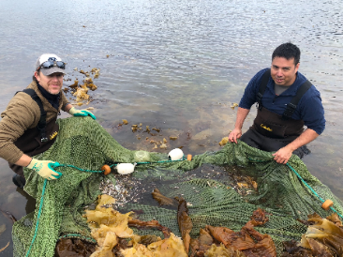
Surveys – monitored
Larger 2017/2018, 2020, and 2022 year classes

Slide 29
Surveys – monitored
Larger 2017/2018, 2020, and 2022 year classes

Slide 30
Data – summary
Length comp trends:
No red flags, other than Pot fleet underrepresented
Index trends:
For all sources (fitted and monitored), that have 2023 data available, increased from previous year
Environmental trends:
Younger year classes do show up in trawl survey
2023 average year, no red flags

Slide 31
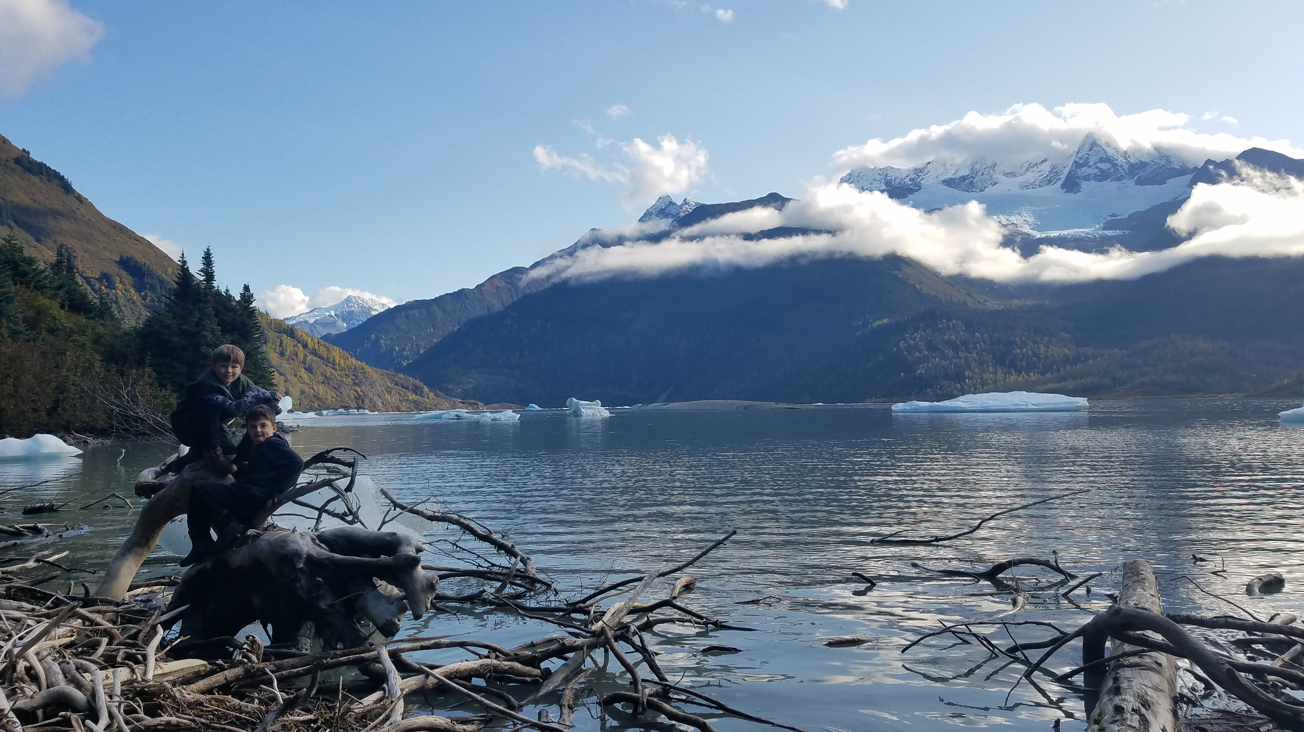
results
Data fits
Parameter/Time Series Estimates
Recommendations
Model diagnostics

Slide 32
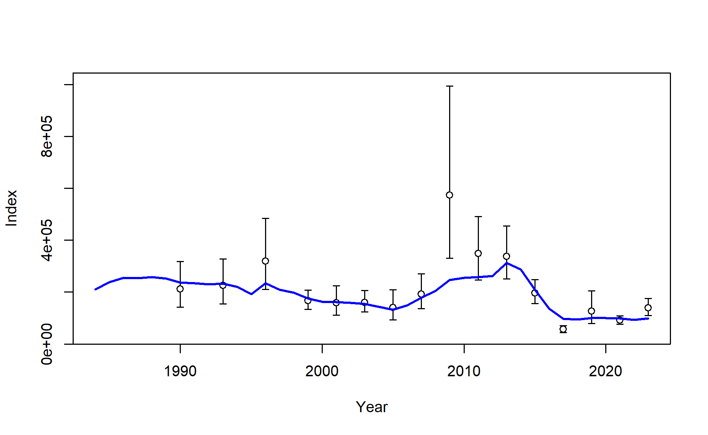
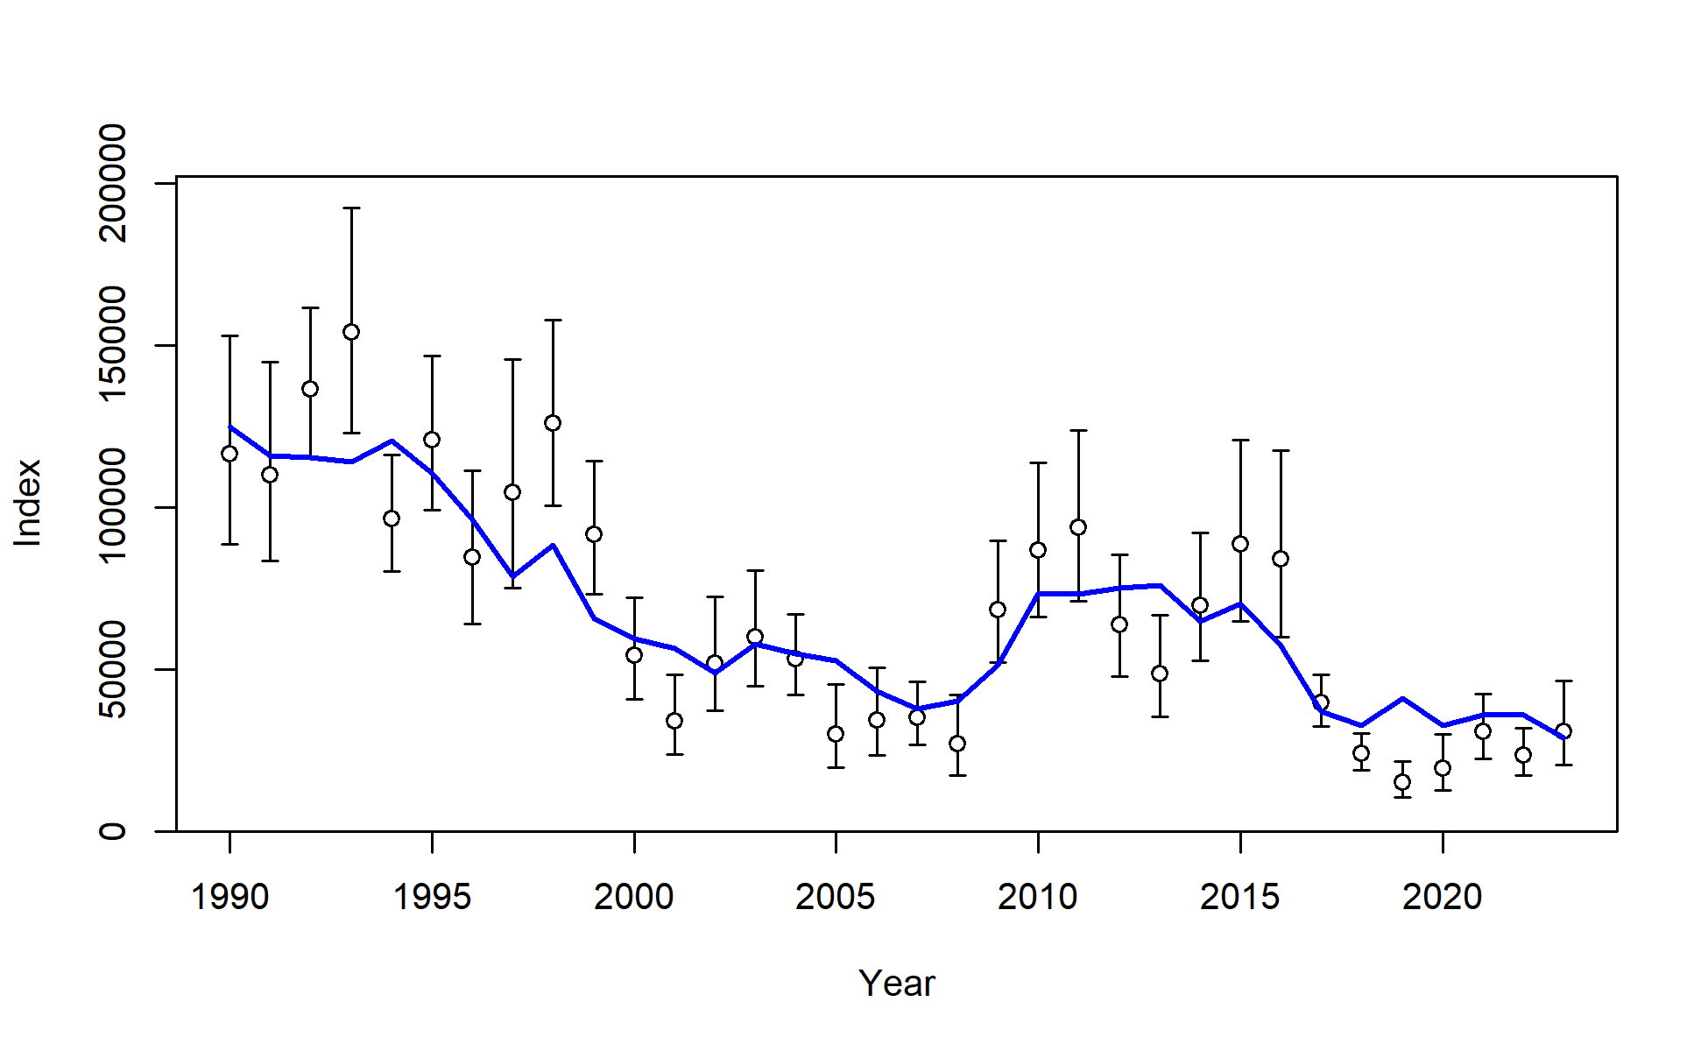
Results: data fits
AFSC bottom trawl survey numbers
Trawl survey fit between lows in 2017 & 2021 and larger in 2019 & 2023 – model expects less abundance than observed in 2023
Pattern of expecting larger RPN from longline survey in 5 of last 6 years, but, model expects less abundance than observed in 2023
AFSC longline survey RPNs

Slide 33
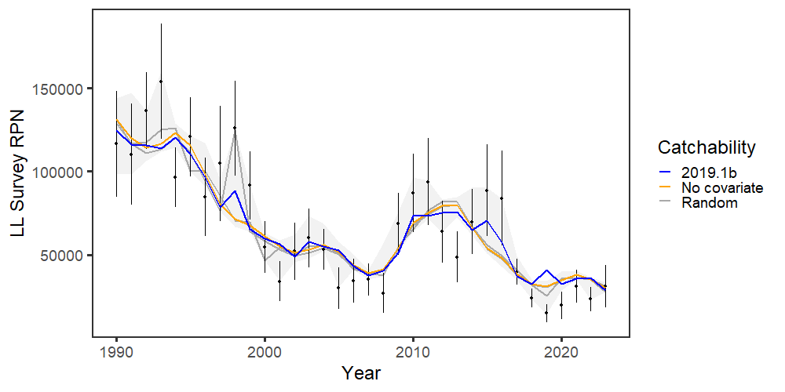
Evaluated longline survey environmental link with 2 tests (use AIC for comparison):
Remove environmental link
Generate ‘white noise’ with N(0,1) and use as environment
Test 1 ΔAIC = 11.4, Test 2 average ΔAIC = 6.9 (45 of 50 runs 19.1b AIC smaller than white noise)

Slide 34
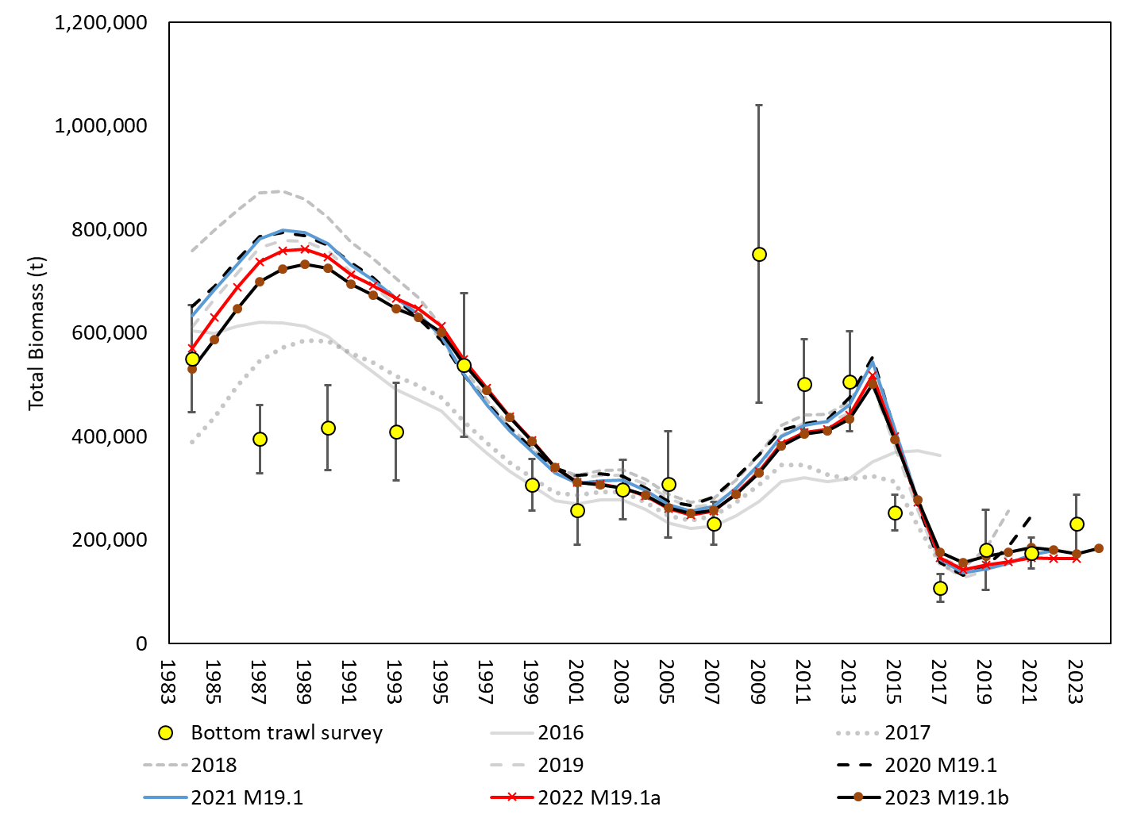
Model retrospective ‘fit’ to biomass variable across assessments
Slight upward shift in 2023 assessment
Results: data fits

Slide 35

In general, model fit to length comp data reasonable
Slight misfit for survey length comp
Keep in mind: weighted ½ of fishery
Results: data fits

Slide 36

Results: parameter estimates
F decreased in 2022 for all fleets, Pot fleet continues to have largest F (keep in mind selex though)

Slide 37


Results: parameter estimates
Below average recruitment since 2014 (following a stanza of above avg recruitment)
Recruitment decreased in the 2023 assessment compared to 2022

Slide 38


Results: parameter estimates
M decreased in 2023 assessment compared to 2022

Slide 39

Results: time series
Compared to 2022 model, 2023 assessment increases estimated SSB in recent time series

Slide 40

Results: time series
SSB projected to decrease in near term, then increase (<0.1% MCMC replicates have SSB < B_{20%} in 2024 and 2025)
Low recent recruitment estimates with precision, projected average recruitment larger than recent recruitments (since 2014)

Slide 41
Model diagnostics:
Leave-one-out: leave a year of data out, leave an updated data source out for current year
MCMC: key parameter histograms, mixing, correlation
Retrospective: data and model for SSB, data for recruitment
Results: model diagnostics

Slide 42

Model diagnostics:
Leave-one-out: In terms of forecasts, 2022 & 2023 data most influential in last 10 years, driven by index data sources
Jitter: (CV of 0.05 and 50 runs) 49 of the 50 converged; 80% at MLE

Slide 43

Model diagnostics: MCMC
MLE and MCMC estimates of key parameters in agreement

Slide 44

Model diagnostics: MCMC
Chains are mixed, correlations that come up are what we would expect

Slide 45


Results: retrospectives
Low recent SSB retrospective pattern in both model and data (but increased from 2022)

Slide 46

Results: retrospectives
Positive retrospective pattern in recruitment: continues to decrease year-class strength as data added

Slide 47
Results - summary
Model fits to indices reasonable, model expects lower index than observed in 2023
Fitting comp data relatively well, not fitting increase in mean length for some data
Model expects larger length-at-age in fit to recent conditional age-at-length data
Continuing to estimate below average year-class strength since 2014
Retrospective pattern in estimated year-class strength, continues to decrease with each assessment
Projecting spawning biomass to decrease through 2025, then increase

Slide 48
Stock status
Risk table
ABC/OFL recommendations
Apportionment
Results: recommendations

Slide 49



Stock status
Tier 3b: on the ramp
Moving down the ramp from 24 to 25 (but up the ramp from 2022 assessment)
Estimated to be above B_{20%} (dashed red line), 2024 = B_{29.6%}
Projected to decrease to B_{27%} in 2025

Slide 50
Risk table
Assessment considerations:
Fits to data reasonable – keep eye on LL survey fit
Below average recruitment estimated in last 7 years, and has undesirable retrospective pattern (balanced by decreasing M estimates) – projections sensitive to these results, but not in the short term
Negative SSB retrospective pattern – but that’s not bad, and not large
There are sources of uncertainty in this assessment, but nothing that is outside the norm for any of our assessments
Description of level 2: “Major problems with the stock assessment; very poor fits to data; high level of uncertainty; strong retrospective bias.” – not the case here
Lower Assessment considerations from Level 2 to Level 1

Slide 51
Risk table
Pop dy considerations:
Low levels of biomass persists – this continues to be a major concern, primarily because of how close to biomass reference limits we are
As estimated by the model, recruitment has been below average since 2014
We’ve learned population is sensitive to environmental conditions
Discussion:
Dig into recruitment: is there any evidence of recent recruitment in data, have we been here before, and what are the consequences?
Dig into relationship between pop’n size/recruitment with past environmental conditions, how has the pop’n responded?

Slide 52
Risk table
Pop dy considerations: Recruitment
Is there any evidence of recent recruitment in data?
2017/18, 2020, and 2022 shows up in length comps, notably in trawl fishery
LL Survey
Trawl Survey
Trawl Fishery

Slide 53




Risk table
Pop dy considerations: Recruitment
Is there any evidence of recent recruitment in data?
Consistent underestimation of recent age +3 abundance
Trawl Survey
Trawl Fishery
Longline
Pot

Slide 54




Risk table
Pop dy considerations: Recruitment
Is there any evidence of recent recruitment in data?
Estimated mean age > observed mean age
Trawl Survey
Trawl
Longline
Pot

Slide 55
Risk table
Pop dy considerations: Recruitment
Is there any evidence of recent recruitment in data? Yes
Age-0 index and mid-water Pollock line up for at least the 2020 and 2022 year classes
These year classes are also seen in Trawl survey length comp data (with 2017/2018 as well), 2020 emerged in Trawl fishery
Is the model fitting it? No
Fit to recent year classes in Trawl length comp data fit poorly (mostly in sense that model expects less than what is in data)
Consistent underestimation of abundance of age 3-4 in age comp data for all data sources
Consistent overestimation of mean age (meaning, the model estimates less younger fish than observed)
Summary: considerable uncertainty in accuracy of model estimates of recent recruitment

Slide 56

Risk table
Pop dy considerations: Recruitment
Have we been here before?
2019 draws eye to how low it is, but others similar in scale to what was seen in late 90s – early 00s

Slide 57

Risk table
Pop dy considerations: Recruitment
Have we been here before?
Data retrospective: 12 consecutive below avg recruitment with data through 2004
2004 assessment
2023 assessment

Slide 58

Risk table
Pop dy considerations: Recruitment
Have we been here before?
Model retrospective: 11 of 14 years with below avg recruitment in 2005 assessment
2023 assessment
2005 assessment
(Thompson and Dorn, 2005)

Slide 59

Risk table
Pop dy considerations: Recruitment
Have we been here before?
Model retrospective: 11 of 14 years with below avg recruitment in 2005 assessment
2023 assessment
2005 assessment
(Thompson and Dorn, 2005)

Slide 60


Risk table
Pop dy considerations: Recruitment
What are the consequences? SSB
Use mean recruitment from 2014 on in projections
Short term consequences: ~ 2% difference in 2024 ABC
Long term consequences: never get back to B_{35%}, hover around B_{29%}
1977 on
2014 on

Slide 61

Risk table
Pop dy considerations: Recruitment
What are the consequences? ABC
With recent mean recruitment, projected ABC dips in short term, then hovers around 30,000 t

Slide 62


Risk table
Pop dy considerations: Recruitment
I recent mean recruitment here to stay, is there a way to rebuild?
2 scenarios rebuild to at or above B_{40%}

Slide 63


Risk table
Pop dy considerations: Recruitment
I recent mean recruitment here to stay, is there a way to rebuild?
2 scenarios rebuild to at or above B_{40%}
Avg F: 2024 ABC ~ 11,000 t, long term ~21,000 t
F75%: 2024 ABC ~ 8,000 t, long term ~ 16,500 t
But, is recent mean recruitment here to stay?

Slide 64
Risk table
Pop dy considerations: Relationships with environmental conditions

Slide 65

Risk table
Pop dy considerations: Relationships with environmental conditions
El Nino:

Slide 66
Risk table
Pop dy considerations:
Low levels of biomass persists – this continues to be a major concern, primarily because of how close to biomass reference limits we are
As estimated by the model, recruitment has been below average since 2014
We’ve learned population is sensitive to environmental conditions
Level 2: “Stock trends are highly unusual; very rapid changes in stock abundance, or highly atypical recruitment patterns.”
Level 3: “Stock trends are unprecedented; More rapid changes in stock abundance than have ever been seen previously, or a very long stretch of poor recruitment compared to previous patterns.”
Based on evidence available, rank at Level 2

Slide 67
Risk table
Environmental/ecosystem considerations:
Conditions have improved compared to recent past
Level 1
Fishery performance:
No signals of adverse performance/behavior
Level 1
But, we have a fleet that constitutes a large amount of catch that is essentially unobserved

Slide 68
Risk table: summary
Assessment-related considerations | Population dynamics considerations | Environmental/ecosystem considerations | Fishery Performance
Level 1: Normal | Level 2: Major concern | Level 1: Normal | Level 1: Normal

Slide 69
ABC/OFL recommendations
Do we reduce from maxABC?
Low levels of biomass will remain a concern until (if) pop’n rebuilds
Recent recruitment estimates concerning, but, there’s evidence model isn’t fitting recent year classes well, and, in terms of magnitude of recruitment, we’ve been here before
Information provided as to consequences of low recent recruitment becoming the norm, and associated catches to rebuild, but, there is substantial uncertainty associated with long term projections
What is risk to stock of doing major damage based on the 2024 ABC recommendation?
If we have a major environmental event in the next year or two, is reducing ABC this year going to mitigate the pop’n decline? Would reduction in catches around 2015 have mitigated pop’n crash?
Will pop’n decrease next year? Possibly, but the model will track any decrease or increase
Keep in mind: stock in Tier 3b, reduction in ABC has already occurred

Slide 70
ABC/OFL recommendations
Historical context:
Short-term (with Model 2019.1 series): 2021 → 2022 ↑39%, 2022 → 2023 ↓25%, was model used to determine stock <B_{20%}
Long-term (with what we estimate from model now): Avg SSB from 2018-2023 24% smaller than 2006-2010, Avg ABC from 2018-2023 (taking out 2020) 64% smaller than 2006-2010
Recommendation: no reduction from maxABC

Slide 71

ABC/OFL recommendations
Recommend Model 19.1b: 31% increase in 2024 ABC compared to 2023

Slide 72


apportionment
Updated with 2023 bottom trawl survey

Slide 73
Current and Future work
Current research:
Krista Oke: env links
OSU: spatial model for WGOA/EBS
Assessment to do:
Look at 2 index REMA model for apportionment
Bin structure
Input sample size for comp data
Look at what data used for conditional age-at-length
Start looking at TMB
Growth evaluations
Something else to consider:
Maturity information

Slide 74
Questions?

Slide 75

AFSC bottom trawl survey length comps

Slide 76

AFSC bottom trawl survey conditional age-at-length

Slide 77


AFSC bottom trawl survey selectivity

Slide 78

AFSC longline survey length comps

Slide 79

AFSC longline survey catchability and selectivity

Slide 80

Trawl fishery length comps

Slide 81

Trawl fishery conditional age-at-length

Slide 82


Trawl fishery selectivity

Slide 83

Longline fishery length comps

Slide 84

Longline fishery conditional age-at-length

Slide 85


Longline fishery selectivity

Slide 86

Pot fishery length comps

Slide 87

Pot fishery condition age-at-length

Slide 88


Pot fishery selectivity

